Slide 1
XM MIPI Jig WOLVERINE Board
internal
Application Department
Tim Lin, Brandy Liu

Slide 2
Outline
Wolverine Structure
Hardware Introduction
Software Introduction
Command List
Instruction Format
Command Description
Program Introduction

Slide 3
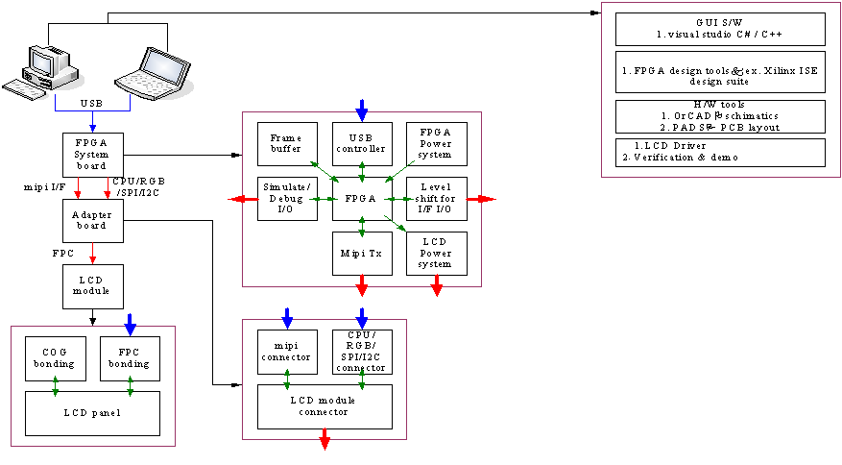
FPGA Structure

Slide 4
Hardware Introduction

Slide 5
Features
FPGA : Spartan6 LX45 CSG484
MIPI Bridge : SSD2828/SSD2828T 4Lane * 1
LDO : LD1117 adj * 2 support 1.2V~15V
RT4832 * 2(VSP*2 , VSN *2 , LEDA*2, LEDK*4)
Support SPI/CPU/I2C/RGB interface.
Support 16 bit GPIO.
Support VIN 5V~15V input
Onboard JTAG for FPGA program
Support USB power and adaptor supply.
Support offline function*.
*Offline function under development.

Slide 6
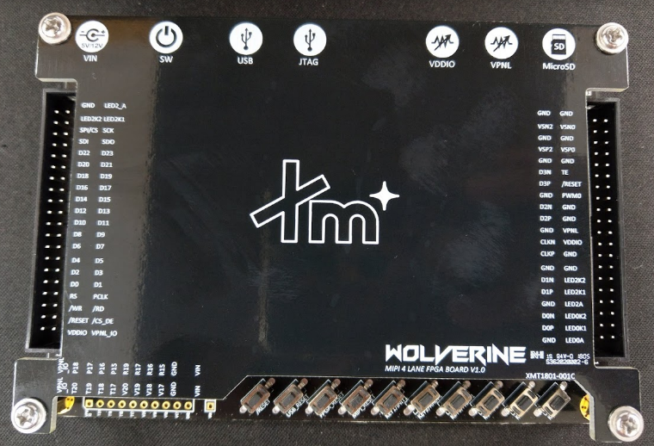
Overview
c
SPI/CPU/I2C/RGB interface.
LD1117 Adj
MIPI interface Power for panel
Power for Backlight
RESET func.
/RESET for Panel
USB_RESET for GL660
FPGA_RESET for FPGA
MIPI_RESET for SSD2828
16bit GPIO voltage = VPNL_IO
Offline func. KEY

Slide 7
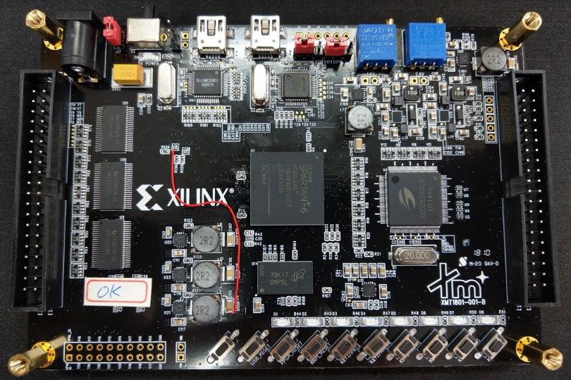
Overview
Power input select
Left : adaptor (default)
Right : USB
FPGA reset mode select
0 : Global reset
1 : Keep RT4832 EN state (for ESD test use)
VPNL_IO and /RESET
output level select
1.8V : Adj by left resistor
2.8V : Adj by right resistor

Slide 8
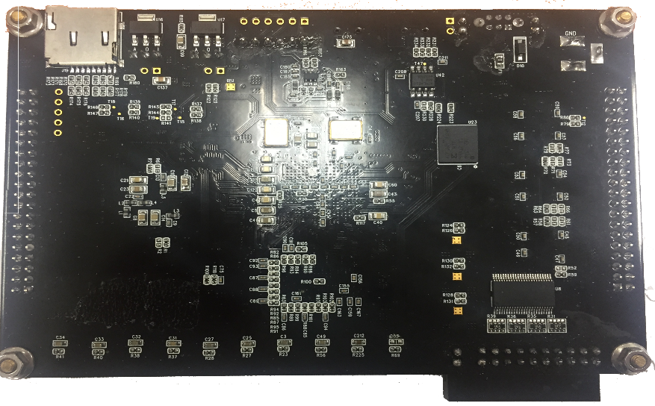
Overview
SD Card

Slide 9
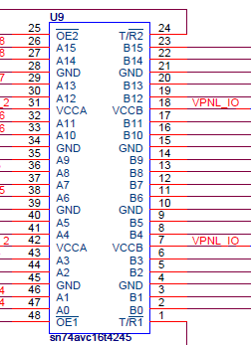
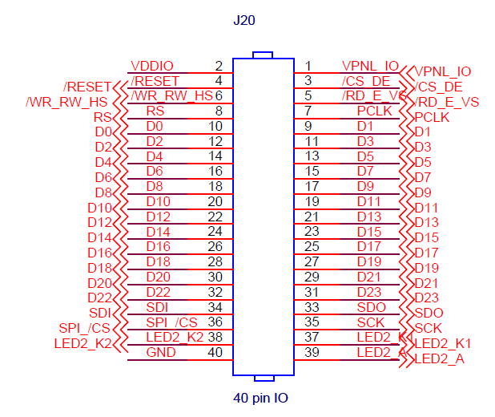

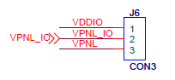
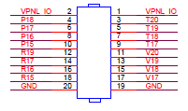
Overview
Note:
＊IO Voltage = VPNL_IO
1.General I/F
2./RESET,PWM0
3.GPIO
Suggestion
VPNL_IO -> LCM VDDIO
VDDIO -> LCM_VPNL

Slide 10
Software Introduction

Slide 11
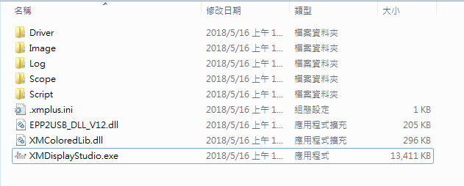
When you Execute XmDisplayStudio
It will automatically create folders
Name | Description
Driver | Xm-Plus USB Controller Driver
Image | Test Pattern
Log | Log Data
Scope | Store Image from Oscilloscope
Script | Verification Script
EPP2USB_DLL_V12.dll | Xm-Plus Bridge Library
XMColoredLib.dll | Xm-Plus Richtextbox Libary

Slide 12
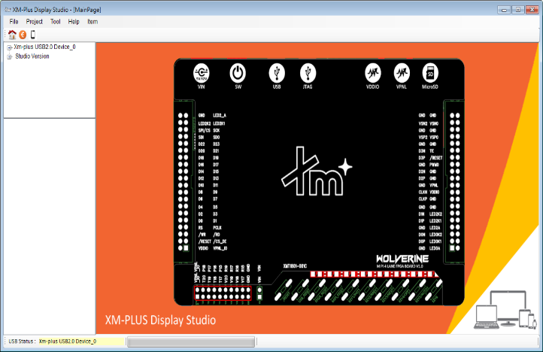
Overview
1. Menu Strip
2. Shortcut Area
2. System Info
3.Image List
4.Active Bridge Info

Slide 13
Overview
Area | Page | Item | Appendix
Menu Strip | File | About | About us
 |  | Exit | Exit Program
 | Project | Verification Page | Verification
 |  | AutoSet Page | Generate general interface
 |  | ManualSet Page | Read and Write Jig Register
 | Tool | USB Flash Edit Tool | Write/Read USB Control Flash
 |  | USB to EPP Command Edit | Write/Read Data to USB Control
 |  | Oscilloscope | Acquire Measurement Picture from Scope
 |  | Pattern_Gen_V13 | Generate Testing Pattern
 |  | SD Card_Control | Download Initial Code or Image into SDCard

Slide 14
Overview
Area | Page | Item | Appendix
Menu Strip | Help | Script Command | Command Lists
 |  | INRUSH_CURRENT_RIPPLE_RELAY_BOARD | Relay Help
 | Item | Temperature Chamber | Testing Item
 |  | Source Measure | Testing Item
 |  | PWM Measure | Testing Item
 |  | Gamma Tool | Testing Item
 |  | MIPI LR SR TEST | Testing Item

Slide 15
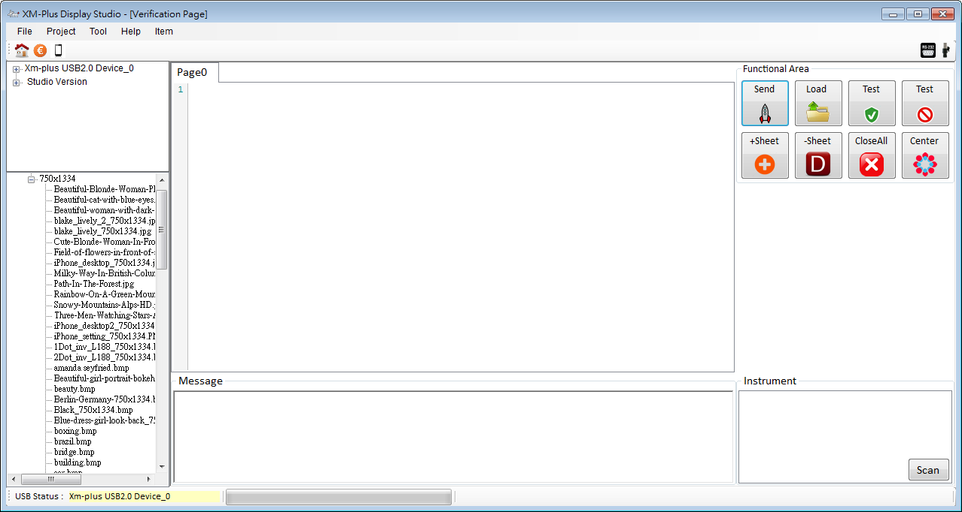
Overview (Verification Page)
When you switch the verification page…
3.Script Area
10.Load Script from Active Page
9.Open Comm Port
1.System Info
8.Open or Cloase CA210 Device
2.Image List
6.Send Script from Active Page
7.Scan Instrument
4.Message Area

Slide 16
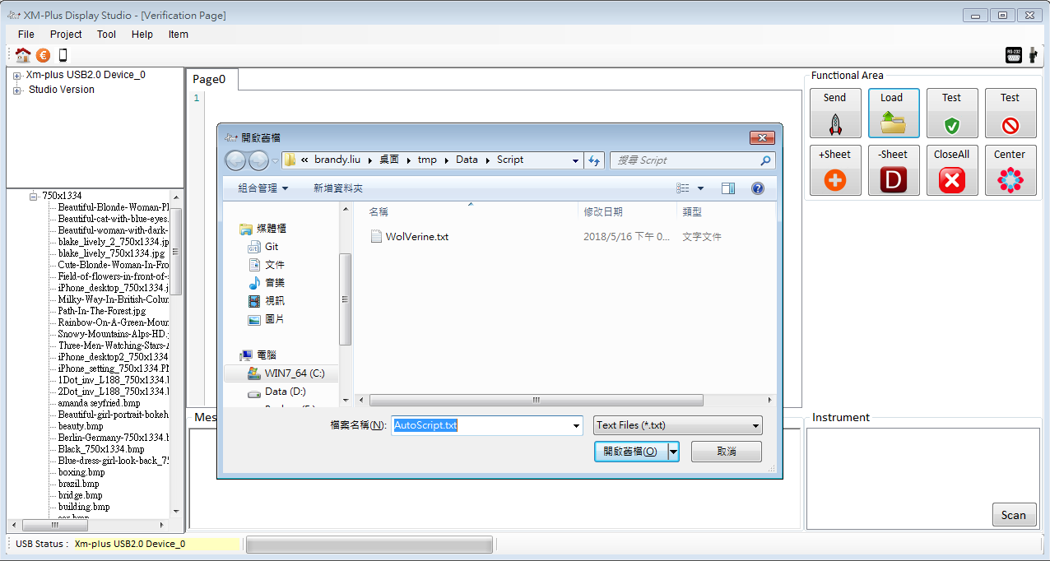
How to Use It?

Slide 17
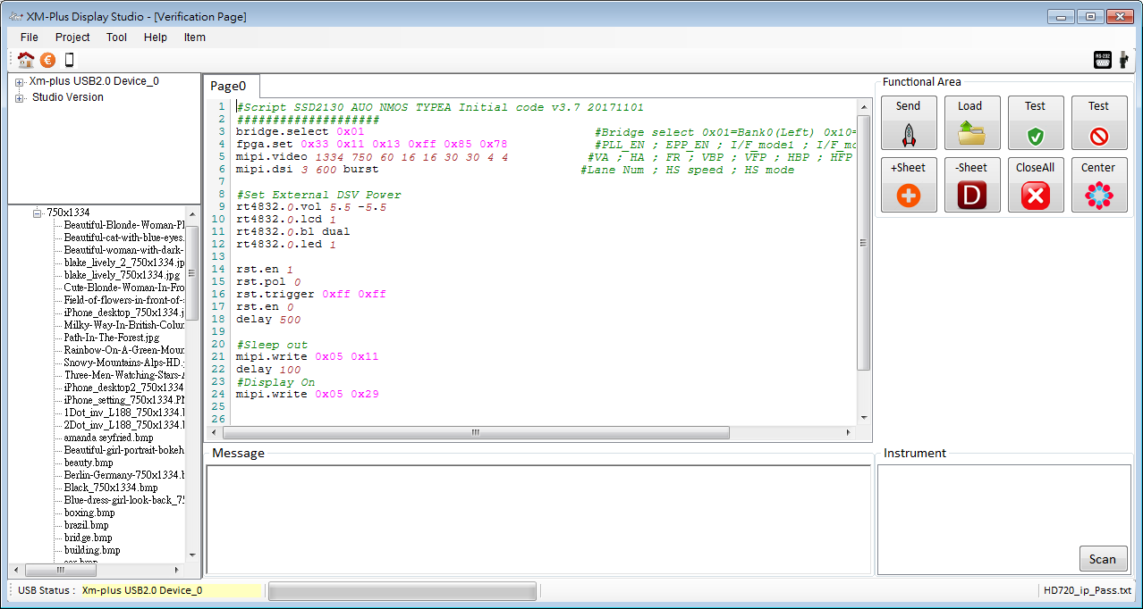
How to Use It?

Slide 18
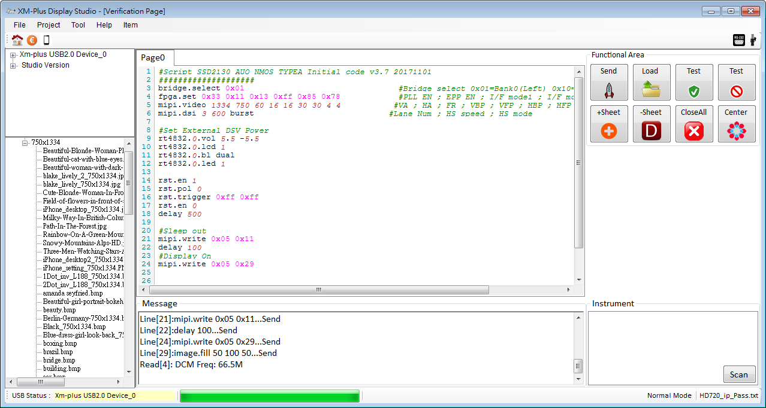
How to Use It?
1.Add Sheet
2.Delete Sheet
3.Delete All Sheets
1.Selection Mode: User Selects part of Script
2.Normal Mode: Send from first Line to end line
File Name in Active Page

Slide 19
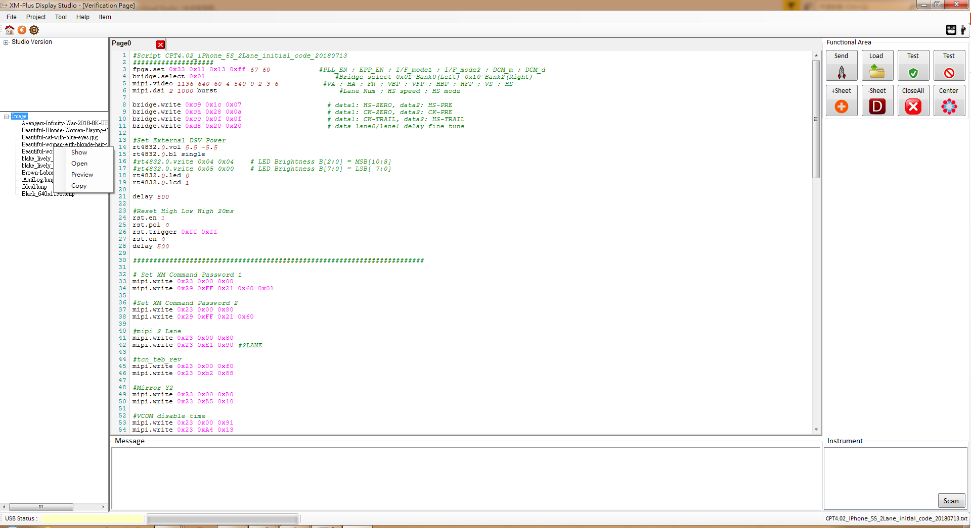
How to Use It?
1. Show: Send Test Pattern To Display
2. Download: Choose Image to Display
3. Preview: Preview the Image
4. Copy: Copy the File Name

Slide 20
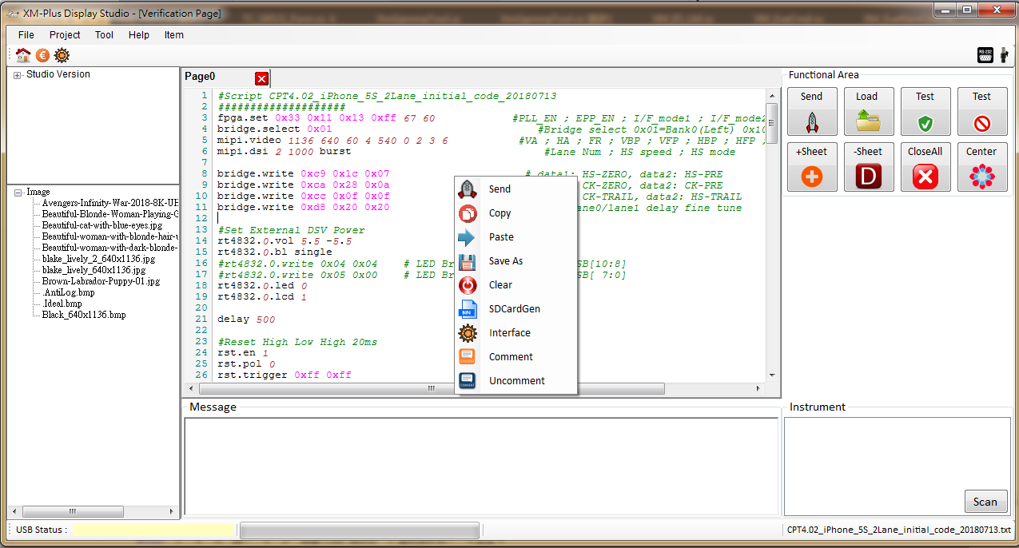
How to Use It?
Parameter | Description
Send | Send the Script to Jig
Copy | Copy the Script
Clear | Clear the Textbox
Save As | Save the Script to the File
Paste | Paste the Script which copy from the other place
Parameter | Description
SDCardGen | Please refer the “MicroSD Control_20181004.pptx”
Interface | Generate general interface for GUI Tool
Comment | Comment the “Mark” Code
UnComment | Uncomment the “Mark” Code

Slide 21
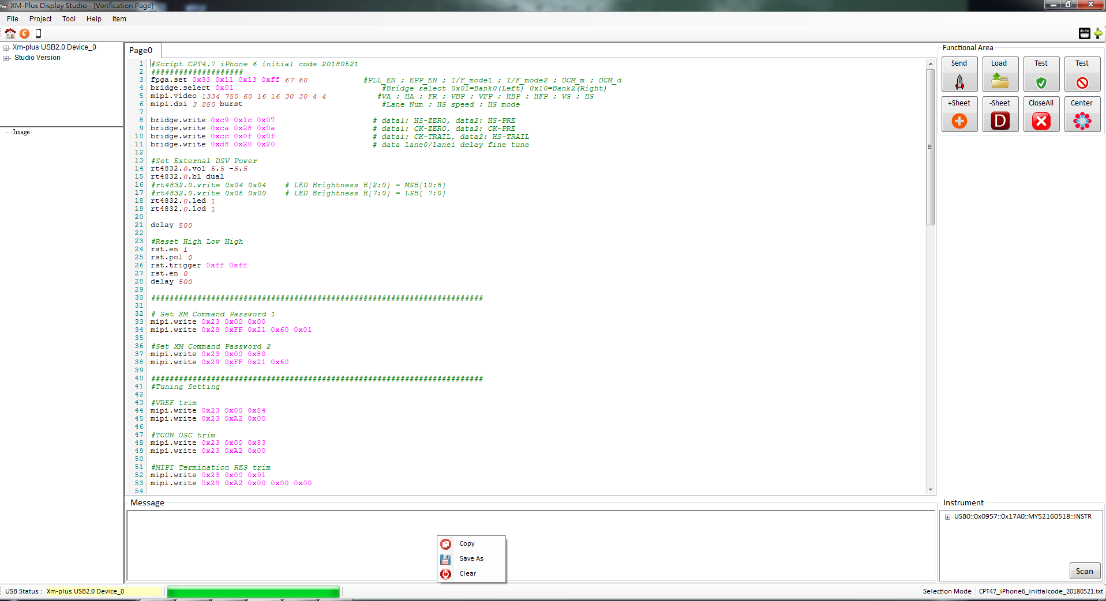
How to Use It?
Parameter | Description
Copy | Copy the Script
Save as | Save the Script as Script
Clear | Clear the Textbox

Slide 22
Command List

Slide 23
Command List
Item | Instruction | Format
1 | fpga.set | Set XmPlus Wolverine Timing
2 | fpga.write | Write Data[] to set XmPlus Wolverine Jig
3 | fpga.read | Read Data[] from XmPlus Wolverine Jig
4 | bridge.write | Write Data[] To MIPI TX Bridge
5 | bridge.read | Read Data[] from MIPI TX Bridge
6 | gpio.dir | Set GPIO Direction, 0:Input 1:Output
7 | gpio.write | Set High Byte and Low Byte GPIO
8 | gpio.h.set | Write Data to the High Byte GPIO Port
9 | gpio.l.set | Write Data to the High Low GPIO Port
10 | gpio.read | Read Data from GPIO Data
11 | gpio.clr | Clear GPIO Status

Slide 24
Command List
Item | Instruction | Format
12 | mipi.dsi | Set MIPI DSI Configure
13 | mipi.video | Set MIPI Video mode Parameter
14 | mipi.write | Send MIPI Packet
15 | mipi.read | BTA Request and Read Packet
16 | mipi.write.hs | Send High-Speed MIPI Packet
17 | mipi.read.hs | BTA Request and Read Packet
18 | mipi.bta | BTA Request
19 | mipi.ulp | MIPI Ultra Low Power
20 | image.fill | Display the Color by adjusting the 24-bit RGB Hex Value
21 | image.show | Display specific image name
image.write Display specific image name

Slide 25
Command List (Instrument)
Item | Instruction | Format
22 | instr.define | Define Instrument to Alias Name
23 | instr.send | Send Data to Instrument
24 | instr.xfer | Send Data to Instrument and read data from Instrument
25 | Instr.read | Read data from Instrument
26 | Instr.close | Close Instrument

Slide 26
Command List (System)
Item | Instruction | Format
27 | version | Read Software Version
28 | delay | Wait for milliseconds
29 | sleep | Wait for milliseconds
30 | scope.show | Call Scope Page to Use
31 | scope.save | Call Scope Method to Save Measure Graph
32 | pause | Stop the Script
33 | for | Repeat range between For and Endfor
34 | endfor | Repeat range between For and Endfor
35 | usb.cmd.write | Data[] must be even, Send Data to control XmPlus Platform
36 | txt.wrstr | Write String to File

Slide 27
Command List (Power)
Item | Instruction | Parameter
37 | rt4832.0.write | Write Data to Control RT4832 0
38 | rt4832.2.write | Write Data to Control RT4832 2
39 | rt4832.0.read | Read Data from RT4832 0
40 | rt4832.2.read | Read Data from RT4832 2
41 | rt4832.0.vol | Set VSP and VSN Voltage to RT4832 0
42 | rt4832.2.vol | Set VSP and VSN Voltage to RT4832 2
43 | rt4832.0.bl | Set Backlight Single/Dual Mode Voltage to RT4832 0
44 | rt4832.2.bl | Set Backlight Single/Dual Mode Voltage to RT4832 2
45 | rt4832.0.lcd | LCD Enable to RT4832 0
46 | rt4832.2.lcd | LCD Enable to RT4832 2
47 | rt4832.0.led | LED Enable to RT4832 0
48 | rt4832.2.led | LED Enable to RT4832 2

Slide 28
Command List (Power)
Item | Instruction | Parameter
49 | rt4832.0.delay | Time between VSP and VSN to RT4832 0
50 | rt4832.2.delay | Time between VSP and VSN to RT4832 2
51 | rt4832.0.set | Set VSP Voltage ,VSN Voltage ,Single/Dual to RT4832 0
52 | rt4832.2.set | Set VSP Voltage ,VSN Voltage ,Single/Dual to RT4832 2
53 | rt4832.0.bright | Set Brightness Value to RT4832 0
54 | Rt4832.2.bright | Set Brightness Value to RT4832 2

Slide 29
Command List (Reset)
Item | Instruction | Parameter Format
55 | rst.en | reset control path, "0": external RC bottom, "1":FPGA internal s/w control
56 | rst.trigger | It Controled by D1 Time and D2 Time
57 | rst.pol | Trigger Type as below
58 | rst.set | Only Set D2 Time and Pol
59 | rst.reset | Trigger
It split into two groups
1. rst.en,rst.trigger, rst.pol
2. rst.set,rst.reset

Slide 30
Command List (Comm Instrument)
Item | Instruction | Parameter Format
60 | ca210.xfer | Send Command and Read Data from CA210 , Store Data to Txt File
61 | ca210.send | Send Command
62 | ca210.read | Read Data from CA210
63 | comm.send | Send Command to Comm Port
64 | comm.xfer | Send Command Comm Port and Read Data from Comm Port
65 | comm.read | Read Data from Comm Port
66 | k80.flicker.read | Read Flicker Data from K80
67 | k80.bright.read | Read Bright Value from K80
68 | chamber.on
69 | chamber.off
70 | chamber.temp

Slide 31
Command List (CPU Instrument)
Item | Instruction | Parameter Format
71 | cpu.addr.write | CPU Address Write
72 | cpu.data.write | CPU Data Write
73 | mcu.cs.h | CS To High
74 | mcu.cs.l | CS To Low

Slide 32
Command List (SPI Instrument)
Item | Instruction | Parameter Format
75 | spi.set | Set SPI Mode Parameter
76 | spi.addr.write | SPI Address Write
77 | spi.data.write | SPI Data Write
78 | spi.cs.h | Set CS to Low voltage
79 | spi.cs.l | Set CS to high voltage

Slide 33
Command List (I2C Instrument)
Item | Instruction | Parameter Format
80 | i2c.set | Set I2C Mode Speed
81 | I2c.addr | Set I2C Slave Address
82 | i2c.write | Write Data through I2C Interface
83 | i2c.read | Read Data from external Device through I2C Interface
84 | i2c.read.num | Set i2c read Number

Slide 34
Command List(Special Device for General Interface )
Item | Instruction | Parameter Format
85 | dev.addr.mode | Set device memory mode
86 | dev.i2c.data.write | Write data for Specified Device through I2C Interface
87 | dev.i2c.addr.write | Write data for Specified Device through I2C Interface
88 | dev.rd | Read Data from Device
89 | dev.dummy.rd | Read Dummy Data from Device

Slide 35
Instruction Format

Slide 36
Command Format
Instruction | Format
fpga.set | Tx_Bank_En | EPP_EN |  | I/F_Mode1 |  | I/F_Mode2 |  |  |  |  |  | DCM_M |  | DCM_D
fpga.write | Address |  | Data |  |  |  |  |  |  | Data |  |  | Data
fpga.read | Address |  |  |  |  |  |  |  | Read Num
bridge.write | Address |  |  |  | Data |  |  |  |  |  | Data
bridge.read | Address |  |  |  |  |  | RdNum
gpio.dir | Gpio Direction
gpio.write | GpioHb |  |  |  |  |  |  | GpioLb
gpio.h.set | Data
gpio.l.set | Data
gpio.read
gpio.clr

Slide 37
Command Format
Instruction | Format
mipi.dsi | Lane Num |  |  |  | Speed |  |  |  | Mode
mipi.video | VLine | HPixels | Framerate |  |  | Vbp |  | Vfp |  | Hbp |  | Hfp | Vsync |  | Hsync
mipi.write | DCS Type |  |  |  |  |  |  |  | Data[]
mipi.read | Address |  |  |  |  |  |  |  | Read Number
mipi.write.hs | DCS Type |  |  |  |  |  |  |  | Data[]
mipi.read.hs | Address |  |  |  |  |  |  |  | Read Number
mipi.bta
mipi.ulp
image.fill | R |  |  | G |  |  | B |  |  |  | File.txt(Opt) |  |  | Para(Opt)
image.show | Image.bmp
image.write Image.bmp

Slide 38
Command Format
Instruction | Format
instr.define | Instrument Addr | Alias
instr.send | Instrument Addr /Alias | Command
instr.xfer | Instrument Addr /Alias | Command
Instr.read | Instrument Addr /Alias
Instr.close | Instrument Addr /Alias

Slide 39
Command Format
Instruction | Format
version
delay
sleep
scope.show
scope.save | Instrument/Alias Name |  | FileName.png
pause | Hint
For | Start | End | step | plus/minus
Endfor
usb.cmd.write | Data[]

Slide 40
Command Format(RT4832)
Instruction | Parameter Format
rt4832.0.write | Register | Data
rt4832.2.write | Register | Data
rt4832.0.read | Register | Read Number
rt4832.2.read | Register | Read Number
rt4832.0.vol | VSP Voltage | VSN Voltage
rt4832.2.vol | VSP Voltage | VSN Voltage
rt4832.0.bl | Single/Dual
rt4832.2.bl | Single/Dual
rt4832.0.lcd | 0/1(disable/enable)
rt4832.2.lcd | 0/1(disable/enable)
rt4832.0.led | 0/1(disable/enable)
rt4832.2.led | 0/1(disable/enable)

Slide 41
Command Format(RT4832)
Instruction | Parameter Format
rt4832.0.delay | [01]=1ms, [10]=2ms, [10]=5ms(delay time between VSP and VSN)
rt4832.2.delay | [01]=1ms, [10]=2ms, [10]=5ms(delay time between VSP and VSN)
rt4832.0.set | VSP Voltage | VSN Voltage | Single/Dual
rt4832.2.set | VSP Voltage | VSN Voltage | Single/Dual
rt4832.0.bright | 0/1(10bit/11bit) | Brightness Value(0~2047)
rt4832.2.bright | 0/1(10bit/11bit) | Brightness Value(0~2047)

Slide 42
Command Format(Reset)
Instruction | Parameter Format
rst.en | 1/0
rst.trigger | D1 Time | D2 Time
rst.pol | 1/0
rst.set | D2 Time | 1/0
rst.reset

Slide 43
Command Format(CA210,COMM)
Instruction | Parameter Format
ca210.xfer | Cmd | Delay | File.Txt
ca210.send | Cmd
ca210.read | File.Txt
comm.send | Data[]
comm.xfer | Data[]
comm.read
k80.flicker.read | File.Txt
k80.bright.read | File.Txt
chamber.on
chamber.off
chamber.temp | Temp

Slide 44
Command Format(General Interface ,CPU)
Instruction | Parameter Format
cpu.addr.write | Cmd[]
cpu.data.write | Cmd[]
mcu.cs.h | No Parameter
mcu.cs.l | No Parameter

Slide 45
Command Format(General Interface ,SPI)
Instruction | Parameter Format
spi.addr.write | Cmd[]
spi.data.write | Cmd[]
spi.cs.h | No Parameter
spi.cs.l | No Parameter
spi.set | CS | SckInv | RdDummy | WrClk | RdClk

Slide 46
Command Format(General Interface ,I2C)
Item | Instruction | Parameter Format
71 | i2c.set | Clock “L” pulse width |  | Clock “H” pulse width
72 | I2c.addr | I2C Slave Address
73 | i2c.write | Data[]
74 | i2c.read | Read Data from external Device through I2C Interface
75 | i2c.read.num | Rd Cnt[20:16] | Rd Cnt[15:8] |  | Rd Cnt[7:0]

Slide 47
Special Device for General Interface
Instruction | Parameter Format
dev.addr.mode | Cmd
dev.i2c.addr.write | Cmd[]
dev.i2c.data.write | Data[]
dev.rd | FileName.txt
dev.dummy.rd | FileName.txt
dev.addr.mode: Set memory addressing mode
00b: Horizontal Addressing Mode
01b: Vertical Addressing Mode
10b: Page Addressing Mode
11b: Invalid

Slide 48
Command Description

Slide 49
fpga.set
fpga.set Pll_Bank_En EPP_EN I/F_Mode1 I/F_Mode2 DCM_M DCM_D
Description: Write Data to Set Jig interface and timing
Parameter | Description
Tx_Bank_En | SSD2828 Bank Enable and Mode Set P[0]:Bank 0 SSD2828 Enable P[1]:Bank 0 SSD2828 Mode, 0:Command Mode, 1:Video Mode P[4]:Bank 2 SSD2828 Enable P[5]:Bank 2 SSD2828 Mode, 0:Command Mode, 1:Video Mode
EPP_EN | P[0]:Bank 0 SSD2828 EPP wr/rd, 0:disable, 1:enable P[4]:Bank 2 SSD2828 EPP wr/rd, 0:disable, 1:enable
I/F_Mode1 | P[5:3] 000:I80 Interface 001:M68 Interface 010:RGB Interface 011:SPI Interface 100:I2C Interface 101:I2c+RGB Interface P[2:0] 000 : SPI 3wire/4wire, write/read 8bit 001 : SPI 3wire, write 9bit/read 8bit 010 : RGB(HS/VS+DE) + SPI 3wire/4wire, write/read 8bit 011 : RGB(HS/VS+DE) + SPI 3wire, write 9bit/read 8bit 100 : RGB(HS/VS) + SPI 3wire/4wire, write/read 8bit 101 : RGB(HS/VS) + SPI 3wire, write 9bit/read 8bit 110 : RGB(DE) + SPI 3wire/4wire, write/read 8bit 111 : RGB(DE) + SPI 3wire, write 9bit/read 8bit

Slide 50
fpga.set
Parameter | Description
I/F_Mode2 | P[7:4] : RGB mode => interface bits define P[3] : mp , Mclk polarity set P[2] : ep , Enable(DE) polarity set P[1] : hsp , Hsync polarity set P[0] : vsp , Vsync polarity set
DCM_M | Jig Frequency= 60(M) * DCM_M / DCM_D
DCM_D
Receive Data: None
Example:
fpga.set 0x33 0x11 0x13 0xff 67 60

Slide 51
fpga.write
fpga.write RegAddr Data0 Data1 Data2
Description: Write Data to the Jig Register
Parameter:
Receive Data: None
Example:
fpga.write 0xfb 0xff
Parameter | Description
Reg Addr | Register Address(1-Byte) -> 0x
Data | Register Value(2-Btye) -> 0x , 0x , …

Slide 52
fpga.read
fpga.read Register ReadNum
Description: Read Several Data from the Jig
Parameter: Register Address
Example:
fpga.read 0xfb 1
Parameter | Description
Register | Register Address(1-Byte)
ReadNum | Count of readings from Jig

Slide 53
bridge.write
bridge.write RegAddr Data
Description: Write Data to the MIPI TX Bridge Chip(SSD2828)
Parameter:
Receive Data: None
Example: bridge.write 0xc9 0x1c 0x07
Parameter | Description
RegAddr | Register Address(1-Byte) -> 0x
Data | Register Value(2-Btye) -> 0x , 0x

Slide 54
bridge.read
bridge.read Register ReadNum
Description: Read Data from the MIPI TX Bridge Chip(SSD2828)
Parameter: Register Address
Parameter | Description
Register | Register Address(1-Byte)
Read Num | Count of readings from the Mipi Tx Bridge
Example:
bridge.read 0xb0 2

Slide 55
gpio.dir
gpio.dir gpiodir
Description: Set GPIO input / output direction
Parameter:
DirHB: Set HB GPIO Direction, Input: 0 , Output:1
DirLB : Set LB GPIO Direction, Input: 0 , Output:1
Receive Data: None
Example:
gpio.dir 0x11
GPIO Input/Output Direction Set
B[7] | B[6] | B[5] | B[4] | B[3] | B[2] | B[1] | B[0]
0 | 0 | 0 | DirHB | 0 | 0 | 0 | DirLB
HB
LB

Slide 56
gpio.write
gpio.write gpiohb gpiolb
Description: Set GPIO output
Parameter:
Receive Data: None
Example:
gpio.write 0x80 0x01
GPIO
 | B[7] | B[6] | B[5] | B[4] | B[3] | B[2] | B[1] | B[0]
HB | R15 | R16 | R17 | R19 | P15 | P16 | P17 | P18
LB | V17 | V18 | V19 | V20 | T17 | T18 | T19 | T20
HB
P18
P17
P16
P15
R19
R17
R16
R15
LB
T20
T19
T18
T17
V20
V19
V18
V17

Slide 57
gpio.h.set
gpio.h.set gpio
Description: Set GPIO(HB) output
Parameter:
Receive Data: None
Example:
gpio.h.set 0xA1
GPIO
 | B[7] | B[6] | B[5] | B[4] | B[3] | B[2] | B[1] | B[0]
HB | R15 | R16 | R17 | R19 | P15 | P16 | P17 | P18
HB
P18
P17
P16
P15
R19
R17
R16
R15

Slide 58
gpio.l.set
gpio.l.set gpio
Description: Set GPIO LB Output
Parameter:
Receive Data: None
Example:
gpio.l.set 0x85
GPIO
 | B[7] | B[6] | B[5] | B[4] | B[3] | B[2] | B[1] | B[0]
LB | V17 | V18 | V19 | V20 | T17 | T18 | T19 | T20
LB
T20
T19
T18
T17
V20
V19
V18
V17

Slide 59
gpio.read
gpio.read
Description: Read GPIO Status
Parameter: No Parameter
Example:
gpio.read

Slide 60
gpio.clr
gpio.clr
Description: Clear GPIO Status
Parameter: No Parameter
Receive Data: None
Example:
gpio.clr

Slide 61
mipi.dsi
mipi.dsi Lane DataRate Mode
Description: Set MIPI DSI Configuration
Parameter:
Receive Data: None
Example:
mipi.dsi 2 1000 burst
Parameter | Description
Lane | The Number of Data Lane (1|2|3|4)
DataRate | High Speed data rate per lane in Mbps unit(Mbps/Lane)
Mode | burst,syncevent,syncpluse

Slide 62
mipi.video
mipi.video vline hPixels framerate vbp vfp hbp hfp vsync hsync
Description: Set MIPI video mode parameter
Example:
mipi.video 1334 750 60 4 540 30 2 3 6
Parameter | Description
vLine | Active vertical display lines per frame
hPixels | Active horizontal display pixels per line
Framerate | Frame rate, fixed value is 60
Vbp | Vertical back porch lines
Vfp | Vertical front porch lines
Hbp | Horizontal back porch
Hfp | Horizontal front porch
Vsync | Vertical sync pluse width
hsync | Horizontal sync pluse width

Slide 63
mipi.write
mipi.write di parm1 parm2 …
Description: Send MIPI short or long packets in low power mode
Example:
mipi.write 0x23 0x00 0x00
Parameter | Description
di | 0x03: Generic SHORT WRITE , no parameter 0x13: Generic SHORT WRITE , 1 parameter 0x23: Generic SHORT WRITE , 2 parameter 0x05: DCS SHORT WRITE , no parameter 0x15: DCS SHORT WRITE , 1 parameter 0x39: DCS Long WRITE
Parm1 | Parameter 1 for DCS Packet
Parm2 | Parameter 2 for DCS Packet

Slide 64
mipi.read
mipi.read RegAddr ReadNum
DI WC_LSB WC_MSB ECC Data0 Data1 CRC_LSB CRC_MSB
DI data0 data1 ECC
Description: Request BTA and read MIPI packet in low power mode
Parameter:
Receive Data: any bytes of MIPI packet data
Example:
mipi.read 0x0a 1
Parameter | Description
Register | Register Address
ReadNum | Count of readings from the LCD Display Driver

Slide 65
mipi.write.hs
mipi.write.hs di parm1 parm2 …
Description: Send MIPI short or long packets in high speed mode
Receive Data: None
Parameter | Description
di | 0x03: Generic SHORT WRITE , no parameter 0x13: Generic SHORT WRITE , 1 parameter 0x23: Generic SHORT WRITE , 2 parameter 0x05: DCS SHORT WRITE , no parameter 0x15: DCS SHORT WRITE , 1 parameter 0x39: DCS Long WRITE
Parm1 | Parameter 1 for DCS Packet
Parm2 | Parameter 2 for DCS Packet

Slide 66
mipi.read.hs
mipi.read.hs RegAddr ReadNum
Description: Request BTA and Read MIPI Packet in High Speed Mode
Parameter:
Receive Data: any bytes of MIPI packet data
Parameter | Description
Register | Register Address
ReadNum | Count of readings from the LCD Display Driver

Slide 67
mipi.bta
mipi.bta
Description: Request BTA
Parameter: None
Receive Data: None
Appendix: only for Verification

Slide 68
mipi.ulp
mipi.ulp
Description: Set the MIPI TX Bridge to Ultra Low Power Mode
Parameter: None
Receive Data: None
Appendix: Only for Verification

Slide 69
image.fill
image.fill 8bit_R 8bit_G 8bit_B FileName.txt
Description: Can be display the color by adjust the 24bit RGB Value
Parameter:
Parameter | Description
8bit_R | Red Color , 0~255
8bit_G | Green Color , 0~255
8bit_B | Blue Color , 0~255
FileName.txt | (Optional) Store the File Name, Default Path is under Log directory

Slide 70
image.fill
Receive Data: None
Example :
if You want to display :
Red Color: image.fill 255 0 0
Green Color: image.fill 0 255 0
Blue Color: image.fill 0 0 255
If you want to display and record it:
image.fill 252 252 252 gamma.txt

Slide 71
image.write
image.write Name
Description: Display specific image name
Parameter: Image FileName
Receive Data: None
Example:
Image.write GirlBoys.bmp
Parameter | Description
Name | Support png and bmp format

Slide 72
image.show
image.show Name
Description: Display specific image name
Parameter: Image FileName
Parameter | Description
Name | Support png and bmp format
Receive Data: None
Example:
Image.show GirlBoys.bmp

Slide 73
instr.define
instr.define Instrument Alias_Name
Description: Define simple names to replace difficult and long names
Parameter:
Receive Data: None
Example:
instr.define USB0::0x2A8D::0x0101::MY57505581::INSTR Meter
＊Please Refer to Appendix Instrument Connection for details
Parameter | Description
Instrument | Real Instrument Name in Keysight IO Libary
Alias Name | Alias Name named by yourself

Slide 74
instr.send
instr.send Instrument Instruction
Description: Send Instruction to Instrument
Parameter:
Parameter | Description
Instrument | Instrument Name or Alias Name
Instruction | Send Instruction to Instrument
Receive Data: None
Example:
instr.define USB0::0x2A8D::0x0101::MY57505581::INSTR Meter
instr.send Meter *CLS
＊*CLS is Command of Keysight Meter and it will clear instrument status
＊Please Refer to Appendix Instrument Connection for details

Slide 75
instr.read
instr.read Instrument Filename.txt
Description: Read Data from Instrument
Parameter:
Parameter | Description
Instrument | Instrument Name or Alias Name
Instruction | Send Instruction to Instrument
FileName.txt | (Optional) Save Data to Filename.txt
Example:
instr.define USB0::0x2A8D::0x0101::MY57505581::INSTR Meter
instr.send Meter *IDN?
instr.read Meter
Read[3]: Keysight Technologies,34465A,MY57505581,A.02.17-02.40-02.17-00.52-03-01
＊Please Refer to Appendix Instrument Connection for details

Slide 76
instr.xfer
instr.xfer Instrument Instruction filename.txt
Description: Send Instruction and Read from Instrument
Parameter:
Parameter | Description
Instrument | Instrument Name or Alias Name
Instruction | Send Instruction to Instrument
FileName.txt | (Optional) Save Data to FileName.txt
Example:
instr.define USB0::0x2A8D::0x0101::MY57505581::INSTR Meter
instr.xfer Meter *IDN?
Read[2]: Keysight Technologies,34465A,MY57505581,A.02.17-02.40-02.17-00.52-03-01
＊Please Refer to Appendix Instrument Connection for details

Slide 77
instr.close
instr.close Instrument
Description: Close the Instrument and clean handler
Parameter:
Parameter | Description
Instrument | Instrument Name or Alias Name
Receive Data: None
Example:
instr.define USB0::0x2A8D::0x0101::MY57505581::INSTR Meter
instr.xfer Meter *IDN?
instr.close Meter
＊Please Refer to Appendix Instrument Connection for details

Slide 78
version
version
Description: Read XmDisplay Studio Version
Parameter: None
Receive Data: A.B.C.D
Data | Description
A | Major Version
B | Minor Version
C | Build number
D | Revision

Slide 79
delay
delay milliseconds
Description: Wait for the amount of time, in milliseconds
Parameter: the amount of time , in milliseconds
Receive Data: None
Example:
delay 100

Slide 80
sleep
sleep milliseconds
Description: Wait for the amount of time, in milliseconds
Parameter: The amount of time , in milliseconds
Receive Data: None
Example:
sleep 100

Slide 81
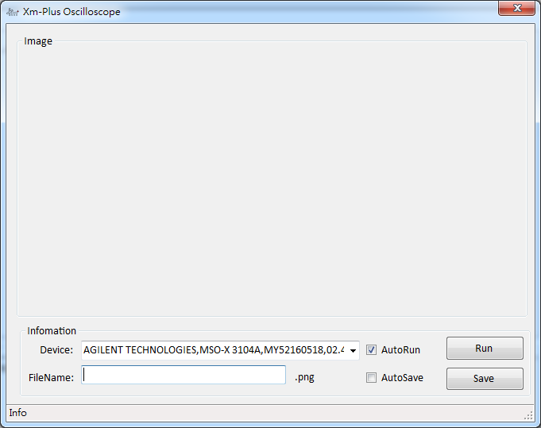
scope.show
scope.show
Description: Retrieve the Measuring Image form Oscilloscope
Parameter: None
Receive Data: None
＊It will find out the all Oscilloscope Device

Slide 82
scope.save
scope.save Instrument ImageName.png
Description: Retrieve the Measuring Image form Oscilloscope and
Save the Image
Parameter:
Parameter | Description
Instrument | Instrument Name or Alias Name
ImageName.png | Save Image FileName.png and store in scope folder.
Receive Data: None
Example:
instr.define USB0::0x0957::0x17A0::MY52160518::INSTR MsoScope
scope.save MsoScope a.png

Slide 83
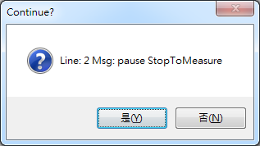
pause
pause Hint
Description: stop and pause the program
Parameter:
Parameter | Description
Hint | It will show the “hint” on the Messagebox
Receive Data: None
Example:
pause StopToMeasure

Slide 84
for
for Initializer Ending Step Iterator
Description: Repeat to Execute the range of ‘for’ to ‘endfor’
Parameter:
Parameter | Description
Initializer | Start Value
Ending | Ending Value
Step | Step , plus or minus It is like “Step++” or “Step --”
iterator
Receive Data: None
Example:
for 0 4 1 plus (for(i=0;i<4;i++))

Slide 85
endfor
endfor
Description: Repeat to Execute the range of ‘for’ to ‘endfor’
Parameter: None
Example:
for 0 256 1 plus
mipi.write.hs 0x23 0x00 0x9b
mipi.write.hs 0x23 0xd4 reg
endfor
Sudo Code:
for (i=0,i< 256;i++)
{
mipi.write.hs 0x23 0x00 0x9b
mipi.write.hs 0x23 0xd4 i
}
＊It can use “reg” to replace the value within the Rage of ‘for’ and ‘endfor’

Slide 86
usb.cmd.write
usb.cmd.write Data[]
Description: Send Data to control XmPlus Platform
Parameter:
Parameter | Description
Data[] | Data[] must be even, Send Data to control Jig Platform It shortens the time among commands
Receive Data: None
Example:
usb.cmd.write 0xfc 0xff

Slide 87
txt.wr
txt.wr Parameter Filename.txt
Description: Save Parameter to FileName.txt
Parameter:
Parameter | Description
Parameter | /n: Next Line /t: Add ‘Tab’ /s: Add ‘Space’
Filename.txt | FileName.txt
Receive Data: None
Example:
txt.wr \n a.txt

Slide 88
rt4832.0.write
rt4832.0.write Register Data
Description: Write Data to RT4832 NO. 1
Parameter:
Parameter | Description
Register | RT4832 Register
Data | Send the Data to RT4832 Register
Receive Data: None
Example:
rt4832.0.write 0x02 0x30

Slide 89
rt4832.0.read
rt4832.0.read Register RdNum
Description: Read Data from RT4832 NO. 1 Register
Parameter:
Parameter | Description
Register | RT4832 Register
RdNum | Number of reading RT4832 Register
Example:
rt4832.0.read 0x01 2
Read[1]: 0x06

Slide 90
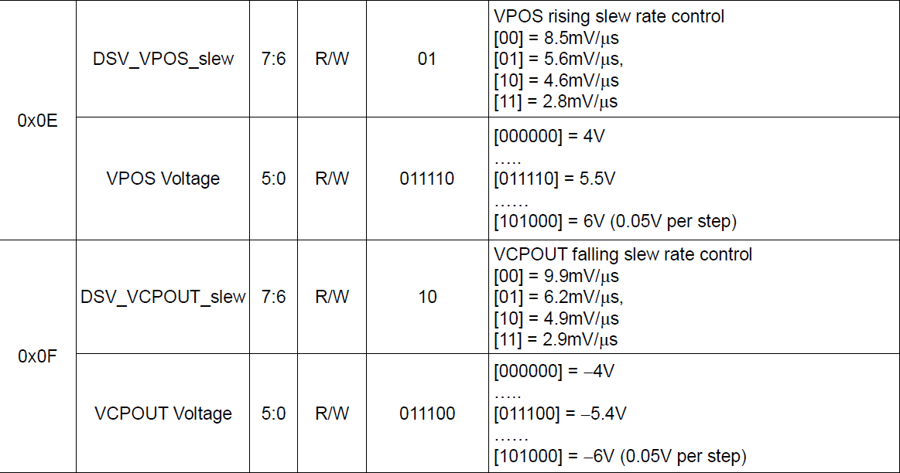
rt4832.0.vol
rt4832.0.vol VSP VSN
Description: Set VSP and VSP Voltage
Parameter:
Parameter | Description
VSP | Set the VSP Voltage, Register Address is 0x0e in RT4832
VSN | Set the VSN Voltage, Register Address is 0x0f in RT4832
Receive Data: None
Example:
rt4832.0.vol 5.5 -5.5

Slide 91
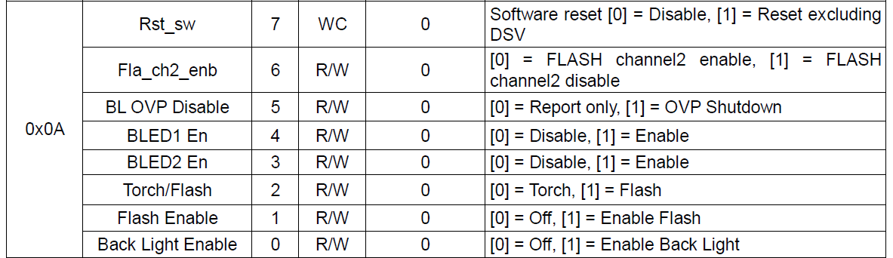
rt4832.0.bl
rt4832.0.bl PowerMode
Description: Set the Back Light Dual Mode or Singe Mode
Parameter:
Parameter | Description
PowerMode | Dual / Single Mode Register Address is 0x0A in RT4832
Receive Data: None
Example:
rt4832.0.bl dual

Slide 92
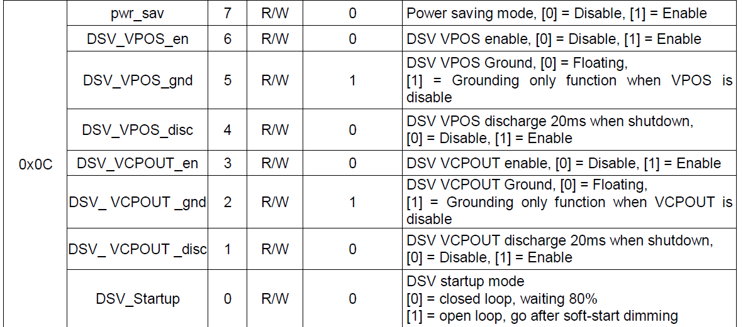
rt4832.0.lcd
rt4832.0.lcd Enable
Description: Enable LCD Power with RT4832 No.0
Parameter:
Parameter | Description
Enable | Enable the LCD Power With RT4832 NO. 0 0:Disable 1:Enable Register Address is 0x0C in RT4832
Receive Data: None
Example:
rt4832.0.lcd 1

Slide 93
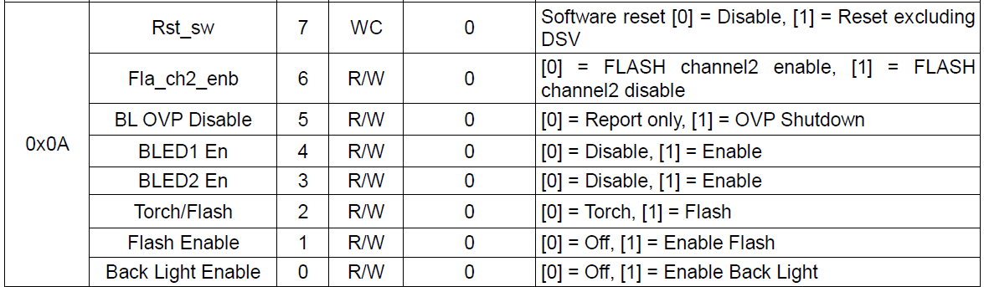
rt4832.0.led
rt4832.0.led Enable
Description: Enable Back Light with No.0 RT4832
Parameter:
Parameter | Description
Enable | Enable the Back Light With RT4832 NO. 0 0:Disable 1:Enable Register Address is 0x0A in RT4832
Receive Data: None
Example:
rt4832.0.led 1

Slide 94
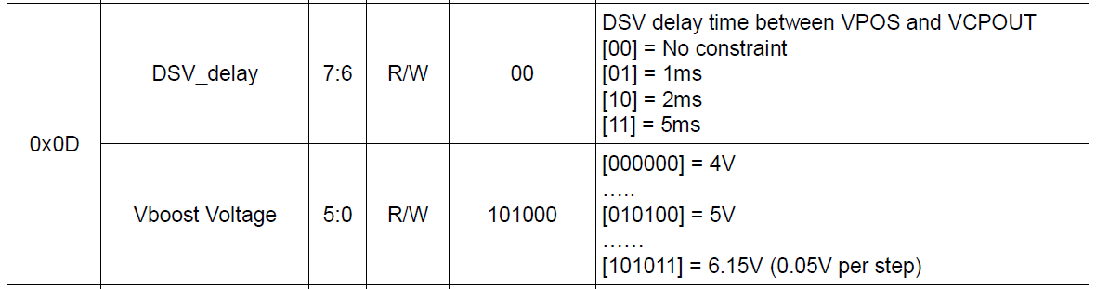
rt4832.0.delay
rt4832.0.delay Time
Description: Delay time between VSP and VSN
Parameter:
Parameter | Description
Time | Delay Tim Between VSP and VSN 0=No Constraint,1=1ms, 2=2ms, 3=5ms Register Address is 0x0D in RT4832
Receive Data: None
Example:
rt4832.0.delay 3

Slide 95
rt4832.0.set
rt4832.0.set VSP VSN Mode
Description: Set VSP , VSN voltage and Back Light Mode
Parameter:
Parameter | Description
VSP | Set the VSP Voltage, Register Address is 0x0e in RT4832
VSN | Set the VSN Voltage, Register Address is 0x0f in RT4832
Mode | Dual / Single Mode
Receive Data: None
Example:
rt4832.0.vol 5.5 -5.5 Dual

Slide 96
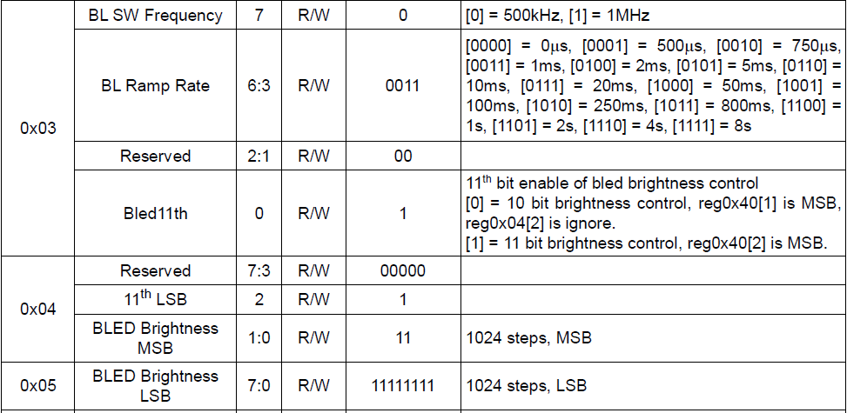
rt4832.0.bright
rt4832.0.set Mode Value
Description: Set Brightness Value to No. 0 RT4832
Parameter:
Parameter | Description
Mode | 0/1(10bit/11bit)
Value | Brightness Value(0~2047)
Receive Data: None
Example:
rt4832.0.bright 1 1024

Slide 97
rst.en
rst.en mode
Description: reset control path
Parameter:
Parameter | Description
mode | 0: external RC bottom, 1:FPGA internal s/w control
Receive Data: None
Example:
rst.en 1

Slide 98
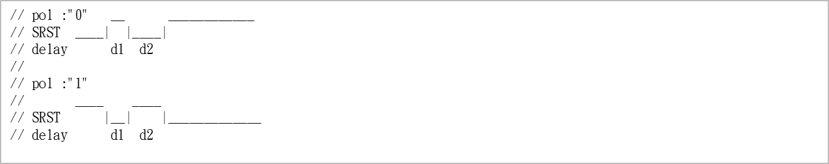
rst.pol
rst.pol mode
Description: Trigger Polarity
Parameter:
Receive Data: None
Example:
rst.en 1
rst.pol 0

Slide 99
rst.trigger
rst.trigger D1Time D2Time
Description:
1. It is controlled by D1 and D2 Time
2. It will reset automatically.
Parameter:
// pol :"0" __ ____________
// SRST ____| |____|
// delay d1 d2
//
// pol :"1"
// ____ ____
// SRST |__| |_____________
// delay d1 d2
Receive Data: None
Example:
rst.en 1
rst.pol 0
rst.trigger 0xff 0xff
＊ D1 Time = 100ns*255 = 25.6us, D2 Time =100 ns*256 = 25.6us, Appendix A

Slide 100
rst.set
rst.set D2Time Polarity
Description:
It is only controlled by D2 Time and Polarity
Parameter:
// pol :"0" __ ____________
// SRST ____| |____|
// delay d1 d2
//
// pol :"1"
// ____ ____
// SRST |__| |_____________
// delay d1 d2
Receive Data: None
Example:
rst.set 0xff 0
rst.reset
＊Refer to Appendix B

Slide 101
rst.reset
rst.reset
Description: It will reset automatically.
Parameter: None
Receive Data: None
Example:
rst.set 0xff 0
rst.reset
＊ rst.set and rst.reset are paired and cannot be used alone

Slide 102
ca210.send
ca210.send Command
Description: Send Command to CA210
Parameter:
Parameter | Description
Command | Send Command to KONICA CA210
Receive Data: None
Example:
ca210.send MES
＊Please Refer to Appendix CA-210 Connection for details

Slide 103
ca210.read
ca210.read FileNam.txt
Description: Read Data from CA210
Parameter: None
Parameter | Description
FileNam.txt | (Optional)Store the File Name, Default Path is under Log directory
Example:
ca210.read a.txt
＊Please Refer to Appendix CA-210 Connection for details

Slide 104
ca210.xfer
ca210.xfer Cmd Time FileName.txt
Description:
Send Command and Read Data from CA210 , Store Data to Txt File
Parameter:
Parameter | Description
Cmd | CA210 Command
Time | Delay Time(Millisecond) Between Sending Command and Reading Data
FileName.txt | (Optional)Store the File Name, Default Path is under Log directory
Example:
ca210.xfer MES 200 NL gamma.txt (Send MES instruction, read data after 200 ms)
＊Please Refer to Appendix CA-210 Connection for details

Slide 105
comm.send
comm.send Command
Description: Send Command Over Serial Port
Parameter:
Parameter | Description
Command | Send Command to Instrument over the Serial Port
Receive Data: None
Example:
comm.send MES

Slide 106
comm.read
comm.read
Description: Read Data from Instrument over the Serial Port
Parameter: None
Example:
comm.read

Slide 107
comm.xfer
comm.xfer Command
Description:
Send Command and Read Data from Instrument over the Serial Port
Parameter:
Parameter | Description
Command | Instrument Command
Example:
comm.xfer Command

Slide 108
k80.bright.read
k80.bright.read FileName.txt
Description:
Read Bright Data from K80 and Store Data to Txt File
Parameter:
Parameter | Description
FileName.txt | (Optional) Store the File Name, Default Path is under Log directory
Example:
k80.bright.read bright.txt (read data and Save Data to bright.txt)

Slide 109
k80.flicker.read
k80.flicker.read FileName.txt
Description:
Read Data from K80 and Store Data to Txt File
Parameter:
Parameter | Description
FileName.txt | (Optional) Store the File Name, Default Path is under Log directory
Example:
k80.flicker.read flicker.txt

Slide 110
chamber.on
chamber.on
Description:
Open the Chamber
Parameter:None

Slide 111
chamber.off
chamber.ff
Description:
Close the Chamber
Parameter:None

Slide 112
chamber.temp
chamber.temp temperature
Description:
Set the Chamber temperature
Parameter: temperature

Slide 113
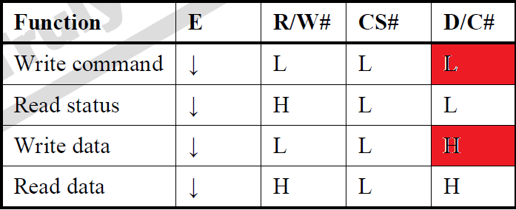
cpu.addr.write
cpu.addr.write command []
Description:
Send Command through CPU Interface
Parameter:
Parameter | Description
Command[] | commands
Example:
cpu.addr.write 0x8d 0x14 0xA1 0xC8 0xAF

Slide 114
cpu.data.write
cpu.data.write command []
Description:
Send data through CPU interface
Parameter:
Parameter | Description
Command | Data[]
Example:
cpu.data.write 0xff

Slide 115
mcu.cs.h
mcu.cs.h
Description:
/CS to High
Parameter: no parameter
Example:
mcu.cs.h

Slide 116
mcu.cs.l
mcu.cs.l
Description:
/CS to Low
Parameter: no parameter
Example:
mcu.cs.l

Slide 117
spi.set
spi.set cs spisckinv rddmyclk spiwrclkh spiwrclkl
Description:
Set SPI timing and function
Parameter:
Parameter | Description
cs | 0:Control by CS bit, 1:Internal module Cycle
spisckinv | 0: SCK Low, Rising Edge latch Data 1: SCK High , falling edge latch data
rddmyclk | 0:no dummy clk 1: with dummy clk
spiwrclkh | write Clk “L” pulse width
spiwrclkl | write Clk “H” pulse width

Slide 118
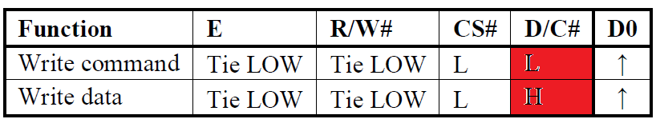
spi.addr.write
spi.addr.write parm[]
Description:
Send Command through SPI interface
Parameter:
Parameter | Description
Parm | Data[]

Slide 119
spi.data.write
spi.data.write parm[]
Description:
Send Command through SPI interface
Parameter:
Parameter | Description
Pram | Data[]

Slide 120
spi.cs.h
spi.cs.h
Description:
Control CS Pin to High Voltage
Parameter: No Parameter
Example:
spi.cs.h

Slide 121
spi.cs.l
spi.cs.l
Description:
Control CS Pin to Low Voltage
Parameter: No Parameter
Example:
spi.cs.l

Slide 122
i2c.set
i2c.set i2c_sckh i2c_sckl
Description:
Set I2C Speed
Parameter:
Parameter | Description
i2c_sckh | i2c sck “H” pluse clk number
i2c_sckl | i2c sck “L” pluse clk number
Example:
i2c.set 0x32 0x32

Slide 123
i2c.addr
i2c.addr slaveaddr
Description:
Set I2C Timing and Speed
Parameter:
Parameter | Description
slaveaddr | I2C Slave Address
Example:
i2c.addr 0x78

Slide 124
i2c.write
i2c.write parms[]
Description:
Write parms[] through I2C Interface
Parameter:
Parameter | Description
Parms[] | Data[]
Example:
i2c.write 0x78 0x87

Slide 125
i2c.read
i2c.read
Description:
Read Data from Device through I2C Interface
Parameter: No Parameter

Slide 126
i2c.read.num
i2c.read.num Rd_H Rd_L
Description:
Set Read Number for I2C
Parameter:
Parameter | Description
Rd_H | I2C Read Num High Byte
Rd_L | I2C Read Num Low Byte
Example:
i2c.read.num 0x12 0x34(0x1234,4660)

Slide 127
dev.addr.mode
dev.addr.mode mode
Description:
Set Memory Addressing Mode
Parameter:
Parameter | Description
Mode | 00b: Horizontal Addressing Mode 01b: Vertical Addressing Mode 10b: Page Addressing Mode 11b: Invalid

Slide 128
dev.i2c.addr.write
dev.i2c.addr.write command[]
Description:
Write Data to Specified Device(XUA003) through I2C Interface
Parameter:
Parameter | Description
Command[] | Data[]
Example:
dev.i2c.addr.write 0x12 0x34

Slide 129
dev.i2c.data.write
dev.i2c.data.write command[]
Description:
Write Data to Specified Device(XUA003) through I2C Interface
Parameter:
Parameter | Description
Command[] | Data[]
Example:
dev.i2c.data.write 0x12 0x34

Slide 130
dev.rd
dev.rd filename.txt
Description:
Read Data from Device
Parameter:
Parameter | Description
Filename.txt | (Optional) Save Data to Filename.txt
Example:
dev.rd a.txt
dev.rd

Slide 131
dev.dummy.rd
dev.dummy.rd filename.txt
Description:
Read Dummy Data from Device
Parameter:
Parameter | Description
Filename.txt | (Optional) Save Data to Filename.txt
Example:
dev.dummy.rd a.txt
dev.dummy.rd

Slide 132
Program Introduction

Slide 133
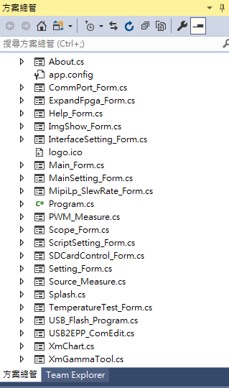
Program Infrastructure
Directory | Document | Description
Main | About.cs
 | Comport_Form.cs | Serial Port Setting Page
 | ExpandFpag_Form.cs | Jig Write/Read Reg Page
 | Help_Form.cs | Introduce Instruction Page
 | InterfaceSetting_Form | Interface Process Setting
 | MainSetting_From.cs | Main Page
 | SDCardControl_Form.cs | Write/Read SdCard Control
 | Scope_Form.cs | Oscilloscope Page
 | ScriptSetting_Form.cs | Control Driver Page
 | Source_Measure.cs | Measure Source Page
 | TemperatureTest.cs | High and low temperature test
 | XmGammaTool | GammaTest

Slide 134
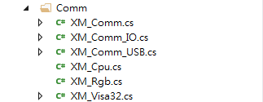
Program Infrastructure
Directory | Document | Description
Comm | XM_Comm.cs | Base Class
 | XM_Comm_IO.cs | Inheritance XM_Comm, only for SDCardCtrl
 | XM_Comm_USB.cs | Inheritance XM_Comm, only for General Control
 | XM_Cpu.cs | Testing Code, Not Use
 | XM_Rgb.cs | Testing Code, Not Use
 | XM_Visa32.cs | Visa Library for Instrument

Slide 135
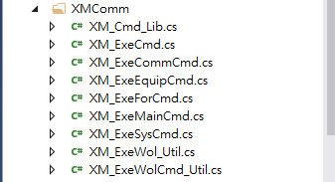
Program Infrastructure
Directory | Document | Description
XmComm | XM_Cmd_Lib.cs | Build up Xm-Plus Command Structure
 | XM_ExeCmd.cs | Base Class for Deal With Jig Command
 | XM_ExeCommCmd.cs | Inheritance Class for Execute Series Port Instruction
 | XM_ExeEquipCmd.cs | Inheritance Class for Execute Equiptment Instruction
 | XM_ExeMainCmd.cs | Library for Classify the Instruction
 | XM_ExeSysCmd.cs | Inheritance Class for Execute System Instruction
 | XM_ExeWol_Util.cs | Utility for Mipi Tx Bridge function
 | XM_ExeWolCmd_Util.cs | Inheritance Class for Execute LCD Display Driver Command

Slide 136
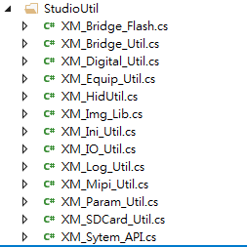
Program Infrastructure
Directory | Document | Description
StudioUtil | XM_Bridge_Flash.cs | Bridge Flash Utility
 | XM_Bridge_Util.cs | API for Search Bridge (Timer)
 | XM_Digital_Util.cs | API for Format interchange(string <-> int, double,float)
 | XM_Equip_Util.cs | API for Control Equipment
 | XM_HidUtil.cs | Testing Code, Not Use
 | XM_Img_Lib.cs | API for Image
 | XM_Ini_Util.cs | API for INI Control (Record Data to INI File)
 | XM_IO_Util.cs | API for File IO Control
 | XM_Log_Util.cs | API for Log System Message
 | XM_Mipi_Util.cs | API for Control Mipi Tx Bridge
 | XM_Param_Util.cs | API for Update and Control Jig(Not Use)
 | XM_SDCard_Util.cs | API for SDCard IO Control
 | XM_Sytem_API.cs | Windows API

Slide 137
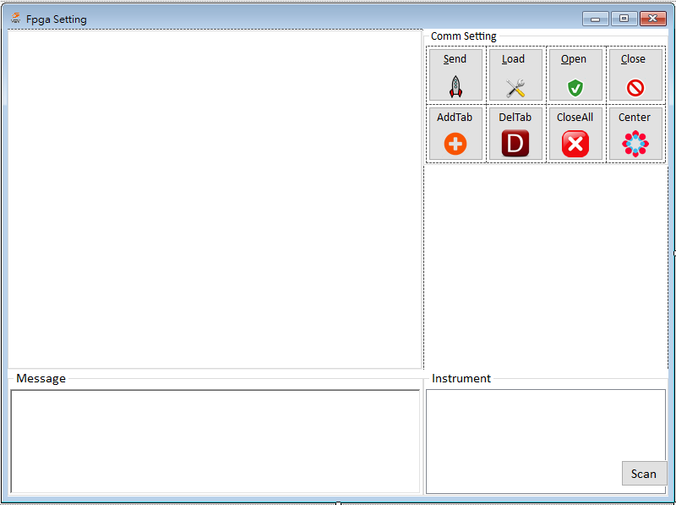
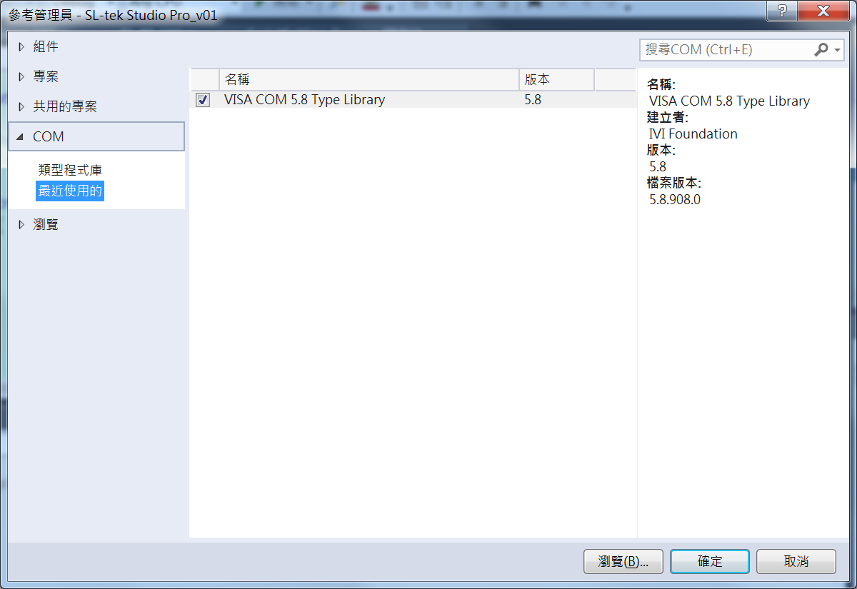
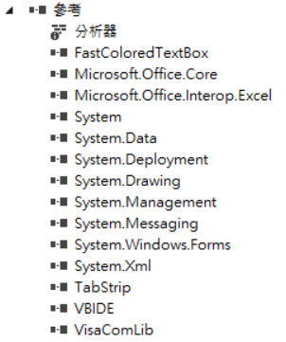
Library
FastColoredTextbox is used to indicate the color of the text

Slide 138
Data Structure
public class XmPlusCmd
{
public string Cmd { get; set; } //Command
public byte Type { get; set; } //Command Type，R/W/WR/Found/Save
public int MaxParm { get; set; } //Parameter Count
public int MaxValue { get; set; } //Max Value
public byte Category { get; set; }
public byte Class { get; set; }
public byte Reg { get; set; } //Register
public int Delay { get; set; } //Delay Time for Next Operation
public ArrayList Item { get; set; } //Fixed Item
}
Class:
0: Comm Command
1: System Command
2: Instrument Command
3. XmPlus Command
4. For Command
5. CA-210 Command
Category :
0: No Parameter
1: Examine Parameter as String
2: Examine Parameter as Numeric
3: Examine Parameter as Numeric and Parameter Num Equal
4. Examine Parameter as String and Parameter Num Equal
5: Examine the last One Item (String,DSI)
6: Examine the last One Item (String,For) and compare value
7. Examine the last one Item as txt file
8: Examine Parameter as Float and the last one is negative
9. Examine Parameter as Reg(Numeric) and Parameter Num Equal
10. Examine Parameter as Reg and the last one Item as txt file
11. Examine Parameter as Reg, The last second as TxtFormat, and the last one Item as txt file

Slide 139
Data Structure
public class ScriptInfo
{
public string Cmd { get; set; } //Command
public string CleanCmd{ get; set; } //Clean Command
public int Index { get; set; } //Command Option among array
public byte Result { get; set; }
public string Msg{ get; set; } //Appendix
public string Line{ get; set; } //Rows
}
public class XmResult
{
public string XmPlusCmd { get; set; } //Command
public int Line { get; set; }
public int End { get; set; }
public bool Result { get; set; } //Check if the format
public XmResult(string XmPlusCmd, int Line, int End, bool Result)
{
this.XmPlusCmd = XmPlusCmd;
this.Line = Line;
this.End = End;
this.Result = Result;
}
}

Slide 140
Program Structure
ScriptSetting_Form.cs
XM_ExeMainCmd.cs
XM_ExeWolCmd_Util
XM_ExeCommCmd_Util
XM_ExeEquipCmd_Util
XM_ExeSysCmd_Util
XM_ExeForCmd_Util
Using
1.Only For Jig Control
Using
1.Comm Device
2.CA210 Device
Using
1.Instrument Control
Support
1.System Command
Using
1.For ,EndFor

Slide 141
Main Program
private void SendXmCmd()
{
string[] CmdLines = null;
bool ret = true, bAllCmd = true;
string ErrInfo = null;
List<ScriptInfo> lScriptInfo = new List<ScriptInfo>();
FastColoredTextBox FastRichBox = (FastColoredTextBox)tctl_pages.TabPages[tctl_pages.SelectedIndex].Controls["FastColoredText"];
/*Verify USB Connection*/
if (!ExeStatus(FastRichBox)) { MessageBox.Show("Stop Running!"); return; }
/*Selection or All*/
CmdLines = WorthXmCmd(FastRichBox, ref bAllCmd).Split(DelimiterChars[4]);
/*Verify and Exam Command*/
ErrInfo = ExeCmd.ExamScript(CmdLines, lScriptInfo);
/*Deal With Error And Present*/
if (bAllCmd && !DealWithXmCmds(FastRichBox, ref lScriptInfo)) { FastRichBox.Focus(); ret = ShowContinueDialog(); }
if (Setting.CmdMsg) rtf_ElecsMsg.Text = ErrInfo;

Slide 142
Main Program
if (ret) // Check if the format is true or false
{
XmCmd XMCmds = new XmCmd(lScriptInfo);
XmThead = new Thread(new ParameterizedThreadStart(Run))
{
IsBackground = true
};
XmThead.Start(XMCmds); //Start Thread
}
else
ExeStatus(FastRichBox);
}

Slide 143
Main Program
public bool ExcuteCmd( string Command, XmPlusCmd XmPlus, ref string RdStr)
{
bool ret = true;
if (XmPlus.Class == 0) ret = DealWithComm(Command, XmPlus, ref RdStr);
if (XmPlus.Class == 1) ret = DealWithSystem(Command, XmPlus, ref RdStr);
if (XmPlus.Class == 2) ret = DealWithEquip(Command, XmPlus, ref RdStr);
if (XmPlus.Class == 3) ret = DealWithWol(Command, XmPlus, ref RdStr);
if (XmPlus.Class == 4) ret = DealWithFor(Command, XmPlus);
if (XmPlus.Class == 5) ret = DealWithKonica(Command, XmPlus, ref RdStr);
return ret;
}
＊if XmPlus.Type == Reg, The result of the reading will be placed in RdStr

Slide 144
How to Use the API(Wolverine)
Sample Code as below
XM_ExeWol_Util XmPlusUtil = new XM_ExeWol_Util();
XMUtil.MipiBridgeSelect(0x01);
XMUtil.SetFpgaTiming(0x33 ,0x11 ,0x13 ,0xff ,67 ,60);
XMUtil.SetMipiVideo(1334, 750, 60, 4, 255, 30, 2, 3, 6);
XMUtil.SetMipiDsi(2, 1000, "burst");
XMUtil.GpioCtrl(0x11, 0x00, 0x00);
XMUtil.BackLight_0_Ctrl(true, false); //Open BackLight
XMUtil.MipiWrite(0x05, 0x11);
Thread.Sleep(100);
XMUtil.MipiWrite(0x05, 0x29)
XMUtil.MipiRead(0x0a, 1, ref rdstr); // rdstr: 0x9c
XMUtil.ImageFill(0, 255, 0);

Slide 145
Appedix

Slide 146
Reset

Slide 147
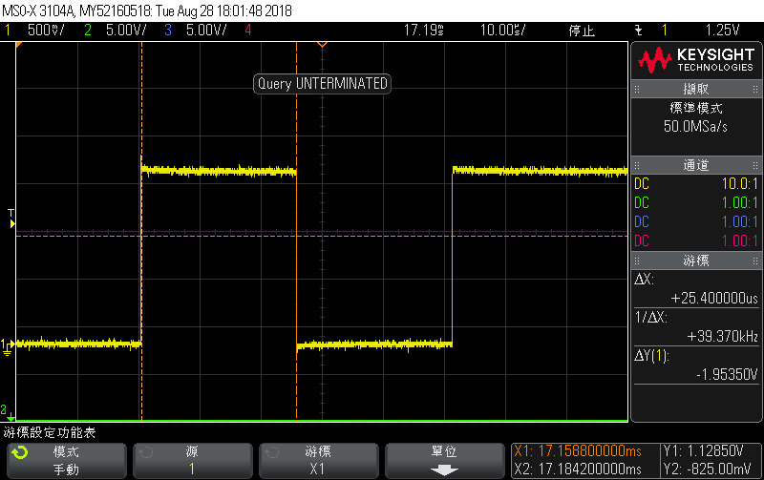
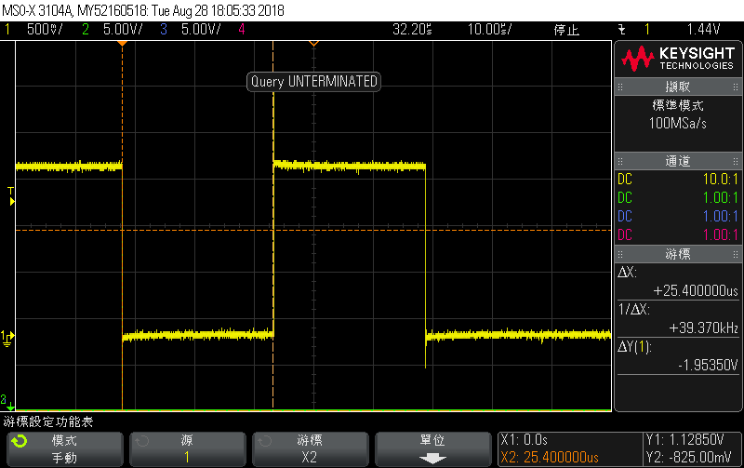
rst.trigger
rst.pol 0
rst.pol 1

Slide 148
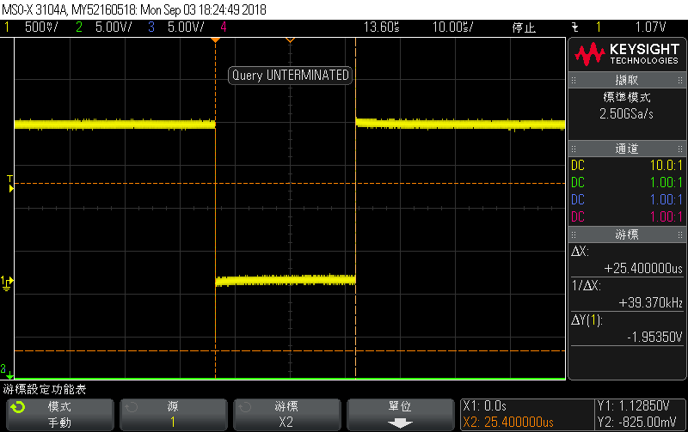
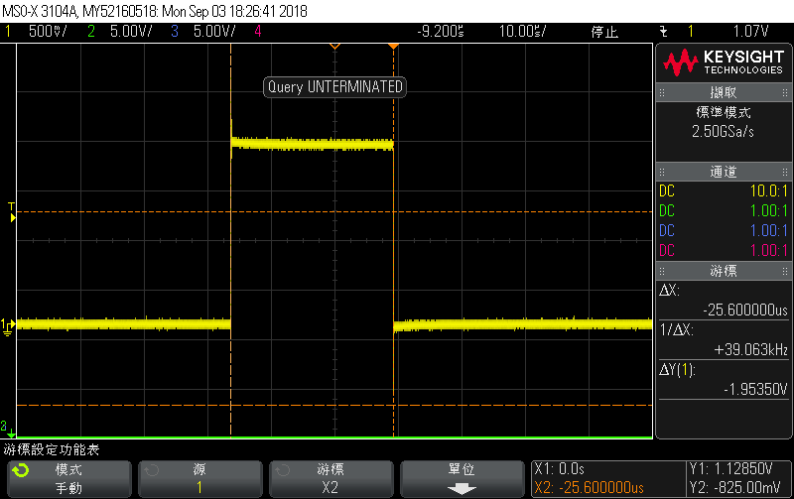
rst.set
rst.set 0xff 0
rst.reset
rst.set 0xff 1
rst.reset

Slide 149
Instrument Connection

Slide 150
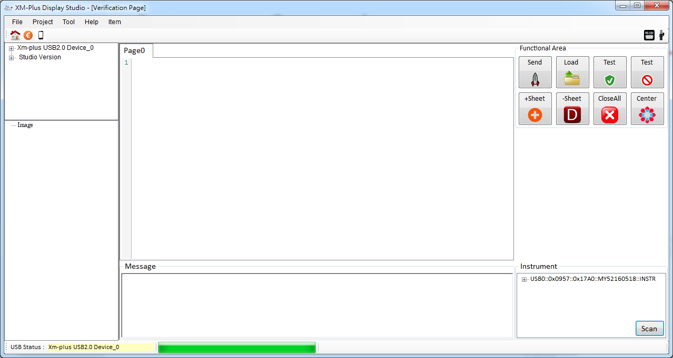
Instrument Connection
1. Please Press “Scan” Button
2. Instrument Names showed in the List

Slide 151
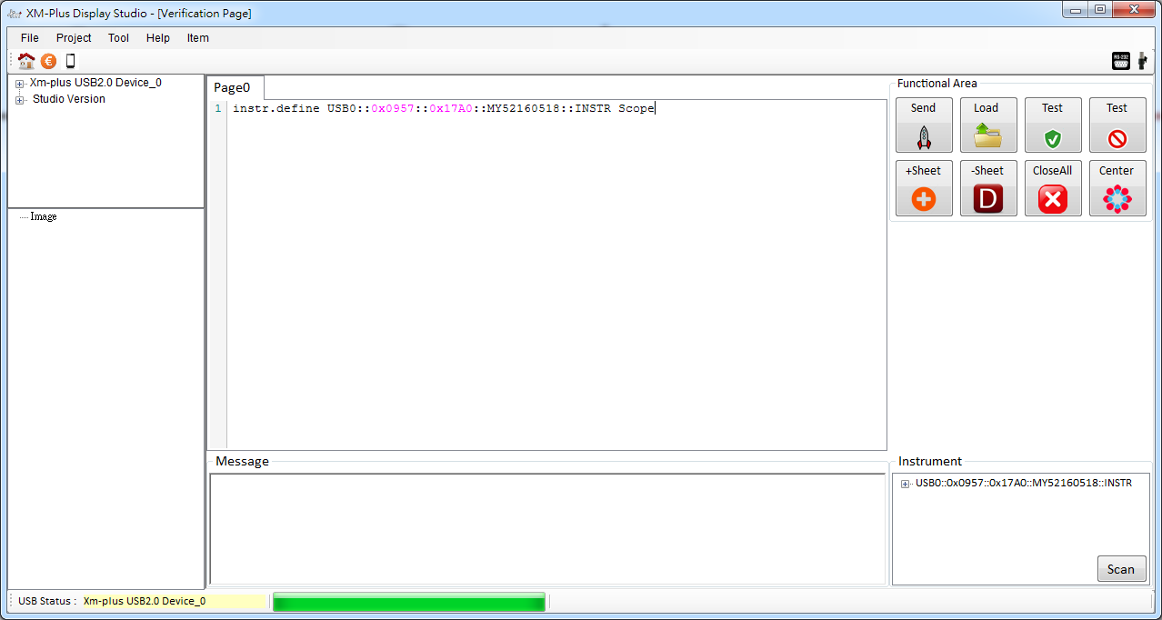
Instrument Connection
1. You can define Instrument Alias Name or use real name

Slide 152
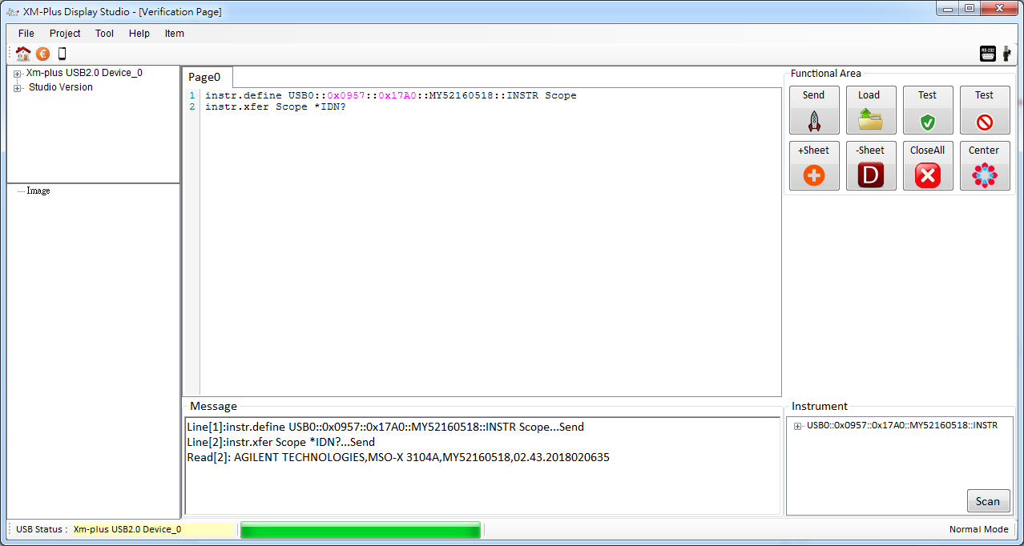
Instrument Connection
1. instr.xfer: Write ‘*IDN?’ to Scope and read
2. Show Reading Message from Scope

Slide 153
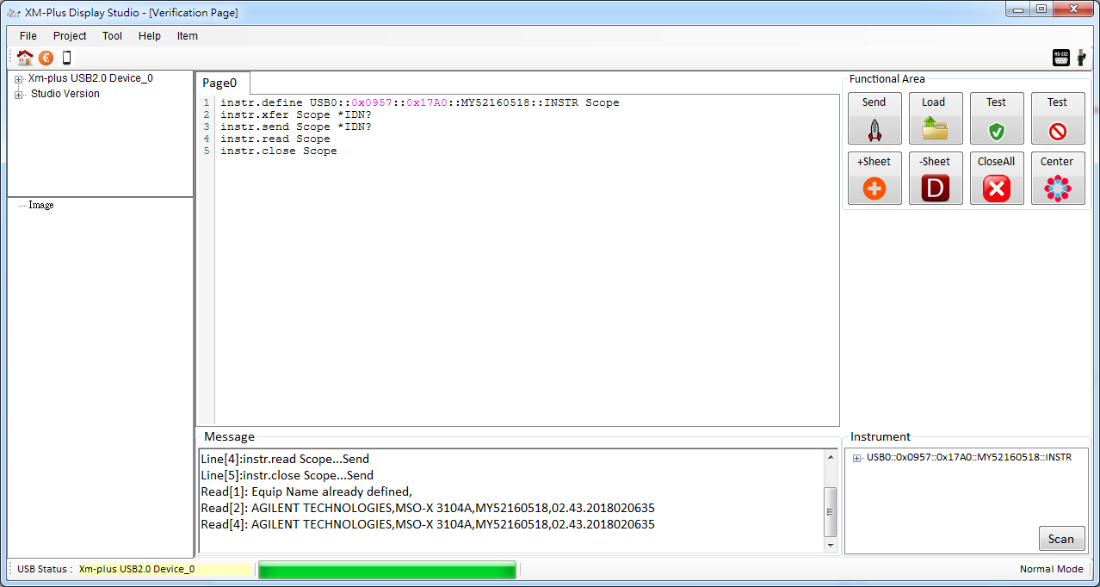
Instrument Connection
1. instr.send: Send ‘*IDN?’ to Scope
2. instr.read: Read from Scope
3. instr.close: Close the Scope

Slide 154
CA-210 Connection

Slide 155
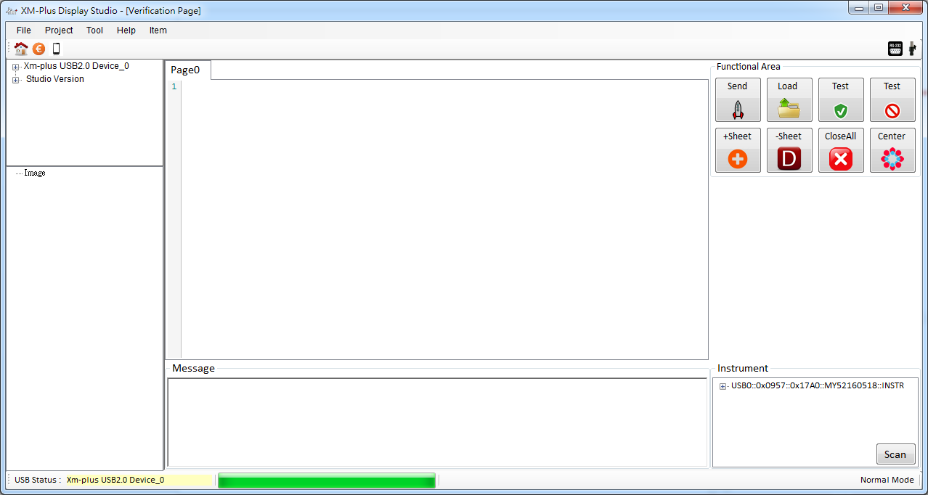
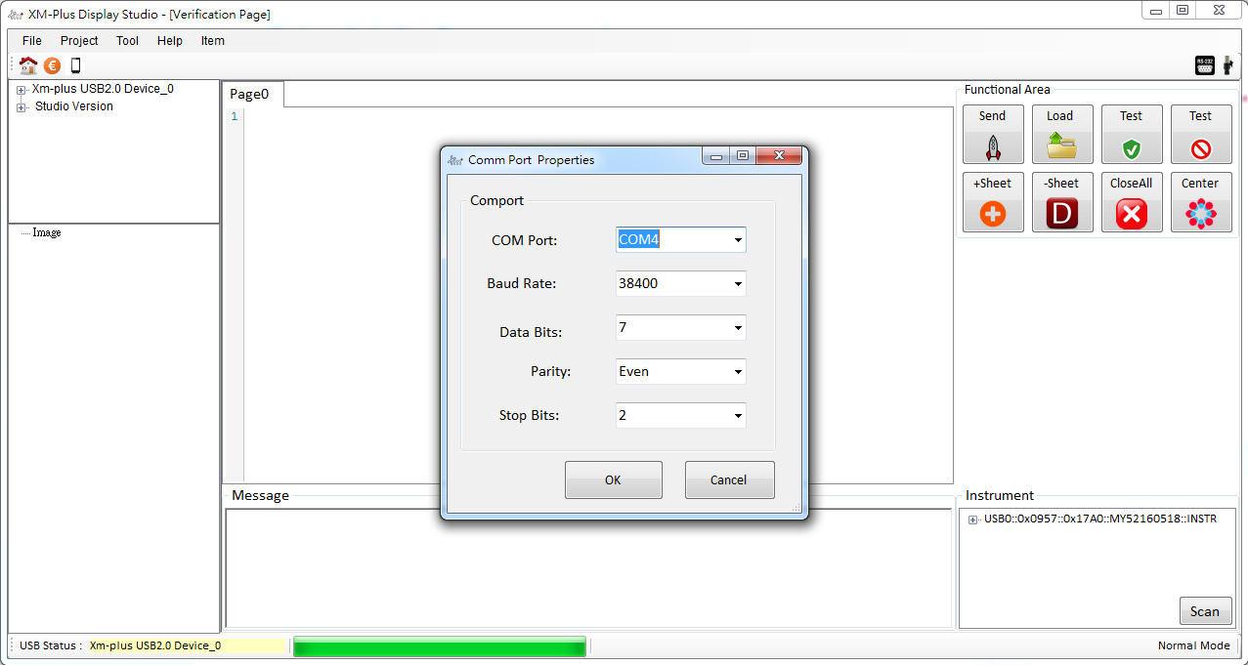
CA-210 Connection
1
2
Open CA210 CommPort
Setting Comm Setting
CommPort, 38400,7,E,2

Slide 156
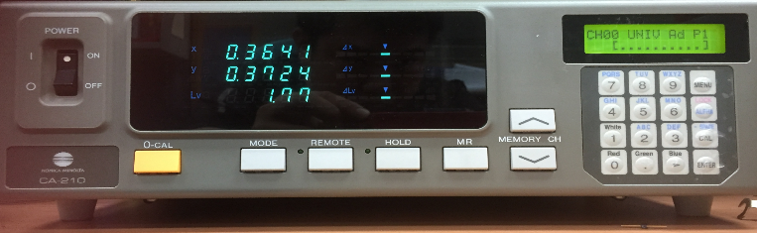
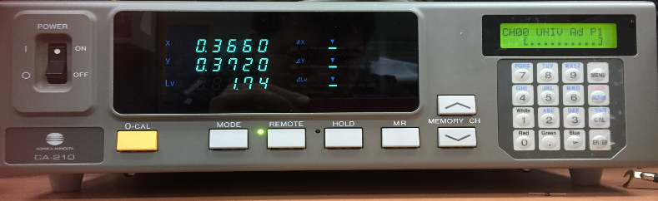
CA-210 Connection
Please Press ‘Remote’ Button

Slide 157
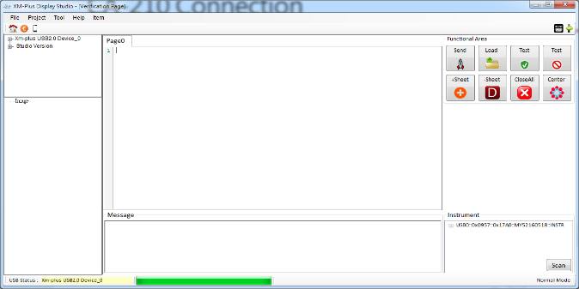
CA-210 Connection
1. Open CA210 Comm Port Successfully

Slide 158
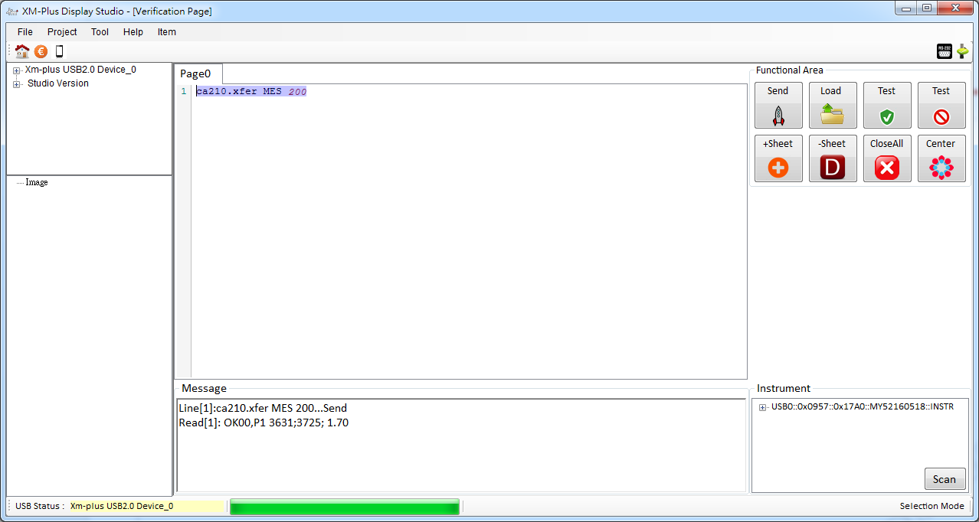
CA-210 Connection
Send ‘Mes’ Command to CA210
After 200 ms , it will read the result from CA210

Slide 159
K-80 Connection

Slide 160
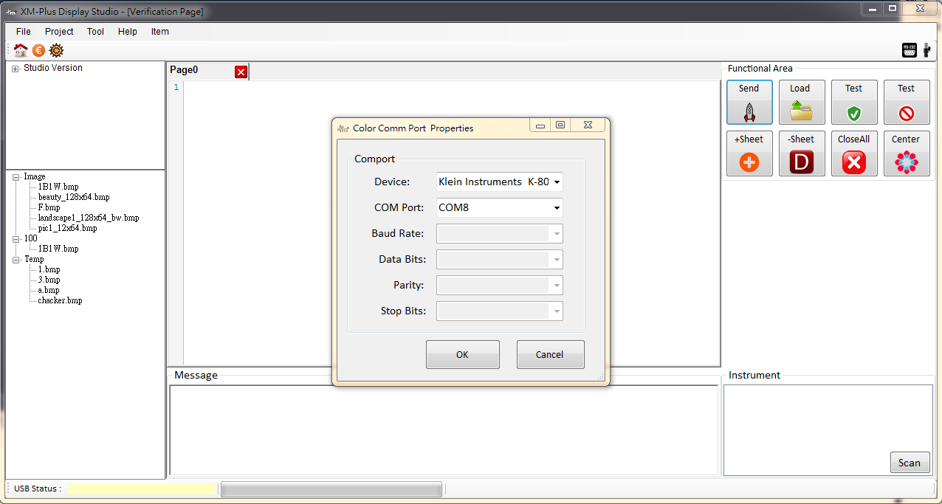
CA-210 Connection
1
2
Open K-80 CommPort
Setting Comm Setting
“K-80”,”COM8”

Slide 161

K-80 Connection
It will read the bright or flicker from CA210

Slide 162
谢谢大家 !

Slide 163
指令說明
USB to EPP |  |  |  | FPGA |  |  |  |  |  | LCD Driver
command | addr strobe | data strobe |  | Register/addr | parameter | mode |  |  |  | interface | register | parameter | display data
EPPAddrWrite | V |  |  | 0x80 | display register and data write/read | addr. WR | FPGA to ext. LCD interface mode |  |  | CPU | function setting register | function setting parameter | display data Write/read
EPPDataWrite |  | V |  | 0x81 |  | data WR |  |  |  | RGB
EPPDataRead |  | V |  | 0x82 |  | addr. RD |  |  |  | SPI
EPPWriteCommand | V | V |  | 0x83 |  | data RD |  |  |  | I2C
WriteScanner |  | V |  | 0x8x | FPGA int. function(SRAM/FLASH/DCM…) |  |  |  |  | mipi
ReadScanner |  | V |  | 0x9x~0xFx | >=1 para. | FPGA int. register

Slide 164
指令說明
Epp address strobe | => | FPGA Register address set
Epp Data strobe write | => | FPGA Register Parameter write
example | LCD I/F | CPU 8bit[7:0]
 | USB to EPP | addr. | data
FPGA initial setting | EPPAddrWrite | 0x9x |  | FPGA timing setting
 | EPPDataWrite |  | 0xXX
 | EPPAddrWrite | 0xa0 |  | FPGA CPU I80/8bit[7:0] interface mode set
 | EPPDataWrite |  | 0x00

Slide 165
指令說明
LCD command setting | EPPAddrWrite | 0x80 |  | FPGA to ext. I/F -> address write mode
 | EPPDataWrite |  | 0x0B | LCD command -> Read display pixel format
 | EPPAddrWrite | 0x83 |  | FPGA to ext. I/F -> data read mode
 | EPPDataRead |  | 0xXX | Read display pixel format
 | EPPAddrWrite | 0x80 |  | FPGA to ext. I/F -> address write mode
 | EPPDataWrite |  | 0x26 | LCD command -> Gamma Set
 | EPPAddrWrite | 0x81 |  | FPGA to ext. I/F -> data write mode
 | EPPDataWrite |  | 0x01 | Gamma Set -> GC0
 | EPPAddrWrite | 0x80 |  | FPGA to ext. I/F -> address write mode
 | EPPDataWrite |  | 0x11 | LCD command -> sleep out
 | EPPDataWrite |  | 0x29 | LCD command -> display on

Slide 166
指令說明
LCD display data write | EPPAddrWrite | 0x80 |  | FPGA to ext. I/F -> address write mode
 | EPPDataWrite |  | 0x2C | LCD command -> memory write
 | EPPAddrWrite | 0x81 |  | FPGA to ext. I/F -> data write mode
 | EPPDataWrite | 擇一 | 0xXX | display data write, loop image size. Ex: 128x160x3 byte |  |  |  |  | Loop
 | WriteScanner |  | 0xXX
LCD display data read | EPPAddrWrite | 0x80 |  | FPGA to ext. I/F -> address write mode
 | EPPDataWrite |  | 0x2E | LCD command -> memory read
 | EPPAddrWrite | 0x83 |  | FPGA to ext. I/F -> data read mode
 | EPPDataRead | 擇一 | 0xXX | display data read, loop image size. Ex: 128x160x3 byte |  |  |  |  | Loop
 | ReadScanner |  | 0xXX

Slide 167
Platform Function Call
C# Instruction: XM_Comm_Base.XM_CommBase_DisWrite(0xf2, 1, 0xff, 1);
Function Call: GLWriteEPPDataPort , GLWriteEPPAddressPort
Flow:
GLWriteEPPAddressPort(0x80)
GLWriteEPPDataPort(0xf2)
GLWriteEPPAddressPort(0x81)
GLWriteEPPDataPort(0xff)
2016/10/31

Slide 168
Platform Function Call
C# Instruction:
byte[] Val = { 0x80, 0xf2, 0x81, 0x61 };
XM_Comm_Base. XM_CommBase_WriteCommand(Val, Val.Length);
Function Call: Epp2USB.UsbWriteCommand(WriteDataPtr, xbufLen);

Slide 169
GL660 Function Call
C# Instruction:
byte[] Val = { 0x11, 0x22,0x33, 0x44 };
XM_Comm_Base.XM_CommBase_DisWrite(0x11, 1, Val, Val.Length);
Function Call:
Epp2USB.UsbWriteScanner
Flow:
GLWriteEPPAddressPort(0x80)
GLWriteEPPDataPort(0x11)
GLWriteEPPAddressPort(0x81)
UsbWriteScanner (val)

Slide 170
Gamma量測修改,Ongoing

Slide 171
修改Gamma量測方法
1. Date:2018/08/23
2. Let User to input sending commands for measuring Gamma.
3. 已經沒有R+ ….. B-的觀念，一個節點就是有P0~p6的點，256(Gray Level)*6, P0~P1535
4.使用預設Script，分成Write And Read Command

Slide 172
修改Gamma量測方法
[WRP0]
mipi.write.hs 0x23 0x00 0x83
mipi.write.hs 0x29 0xD4 P0[D9:D2]
mipi.write.hs 0x23 0x00 0x9E
mipi.write.hs 0x29 0xD4 P0[00,D1:D0,0010]
mipi.write.hs 0x23 0x00 0x83
mipi.write.hs 0x29 0xD5 P1[9:2]
mipi.write.hs 0x23 0x00 0x9E
mipi.write.hs 0x29 0xD5 P1[000000,3:2]
mipi.write.hs 0x23 0x00 0x83
mipi.write.hs 0x29 0xD6 P2[9:2]
mipi.write.hs 0x23 0x00 0x9E
mipi.write.hs 0x29 0xD6 P2[000000,3:2]
mipi.write.hs 0x23 0x00 0x83
mipi.write.hs 0x29 0xD7 P3[9:2]
mipi.write.hs 0x23 0x00 0x9E
mipi.write.hs 0x29 0xD7 P3[000000,3:2]
[WRP1]
mipi.write.hs 0x23 0x00 0x83
mipi.write.hs 0x29 0xD4 P0[D9:D2]
mipi.write.hs 0x23 0x00 0x9E
mipi.write.hs 0x29 0xD4 P0[00,D1:D0,0010]
mipi.write.hs 0x23 0x00 0x83
mipi.write.hs 0x29 0xD5 P1[9:2]
mipi.write.hs 0x23 0x00 0x9E
mipi.write.hs 0x29 0xD5 P1[000000,3:2]
mipi.write.hs 0x23 0x00 0x83
mipi.write.hs 0x29 0xD6 P2[9:2]
mipi.write.hs 0x23 0x00 0x9E
mipi.write.hs 0x29 0xD6 P2[000000,3:2]
mipi.write.hs 0x23 0x00 0x83
mipi.write.hs 0x29 0xD7 P3[9:2]
mipi.write.hs 0x23 0x00 0x9E
mipi.write.hs 0x29 0xD7 P3[000000,3:2]
mipi.write.hs 0x23 0x00 0x83
mipi.write.hs 0x29 0xD8 P4[9:2]
mipi.write.hs 0x23 0x00 0x9E
mipi.write.hs 0x29 0xD8 P4[000000,3:2]
mipi.write.hs 0x23 0x00 0x83
mipi.write.hs 0x29 0xD9 P5[1:0],P6[1:0],P5[1:0],P5[1:0]
mipi.write.hs 0x23 0x00 0x9E
mipi.write.hs 0x29 0xD9 P5[000000,3:2]
mipi.write.hs 0x23 0x00 0x83
mipi.write.hs 0x29 0xD8 P4[9:2]
mipi.write.hs 0x23 0x00 0x9E
mipi.write.hs 0x29 0xD8 P4[000000,3:2]
mipi.write.hs 0x23 0x00 0x83
mipi.write.hs 0x29 0xD9 P5[9:2]
mipi.write.hs 0x23 0x00 0x9E
mipi.write.hs 0x29 0xD9 P5[000000,3:2]

Slide 173
修改Gamma量測方法
[RGamma0]
mipi.write 0x23 0x80
mipi.read 0xD4 1 P0[d9:d4,000,d0]
mipi.write 0x23 0x9E
mipi.read 0xD4 2 P0[d1:d0]:P1[d1:d0]:P3[d1:d0]:P5[d1:d0],P0[d9:d2] ,……..

Slide 174
Interface
Interface | Description
SPI | 0xa0,0x94 , 0x95, 0x96
I80 | 0xa0=>0x00
M68 | 0xa0=>0x08
I2C | 0xa0
resetH | 0x90
fgpa.set
fpga.set | Pll_Bank_En | EPP_EN | I/F_Mode1 | I/F_Mode2 | DCM_M | DCM_D

Slide 175

Interface

Slide 176
Interface Setting
fpga.set
cpu.set
spi.set
i2c.set
spi.write
i2c.write
cpu.write
Rgb.image.fill
Rgb.image.show

Slide 177
PLL設定
1.SSD2828 Bank Enable and Mode Set
If Bank =1 and Video Mode =1 , PLL Enable(Reg:0xF3)
2. IfA0[5:3]:010 or 101 , PLL Enable(Reg:0xF3)

Slide 178
Details
1.SSD2828 Bank若先Enable,則其他DataPath先Disable

Slide 179
SPI

Slide 180

SPI
fpga.write 0xa0 0x18
fpga.write 0x95 0x22
fpga.write 0x96 0x44
fpga.write 0x94 0x00
fpga.write 0x90 0x03
fpga.write 0x90 0x02
cpu.addr.write 0xA5
fpga.write 0x90 0x03
fpga.write 0x90 0x02
cpu.data.write 0x5A
fpga.write 0x90 0x03
CS
SCK
SDI
D/C

Slide 181

SPI

Slide 182
Bug

Slide 183
Gpio.set reg , Shutdown

